Slide 1
2024 Ruijie Warranty and Premium Services -- For Enterprise

Slide 2
Version Information
Last Edit Date | Version | Update By
May 10, 2024 | V1.0 | Joan
Aug 20, 2024 | V2.0 | Joan

Slide 3
About Ruijie Service
As an ICT infrastructure and solution provider, Ruijie has taken service as its foundation since its inception. Ruijie Networks has established a set professional service system in the service network, service processes, service staff, and service tools based on practical experience to help customers access Ruijie’s high-quality service.
Ruijie will improve the service management system and service product continually based on customer’s requirements with a forward-looking sight.

Slide 4
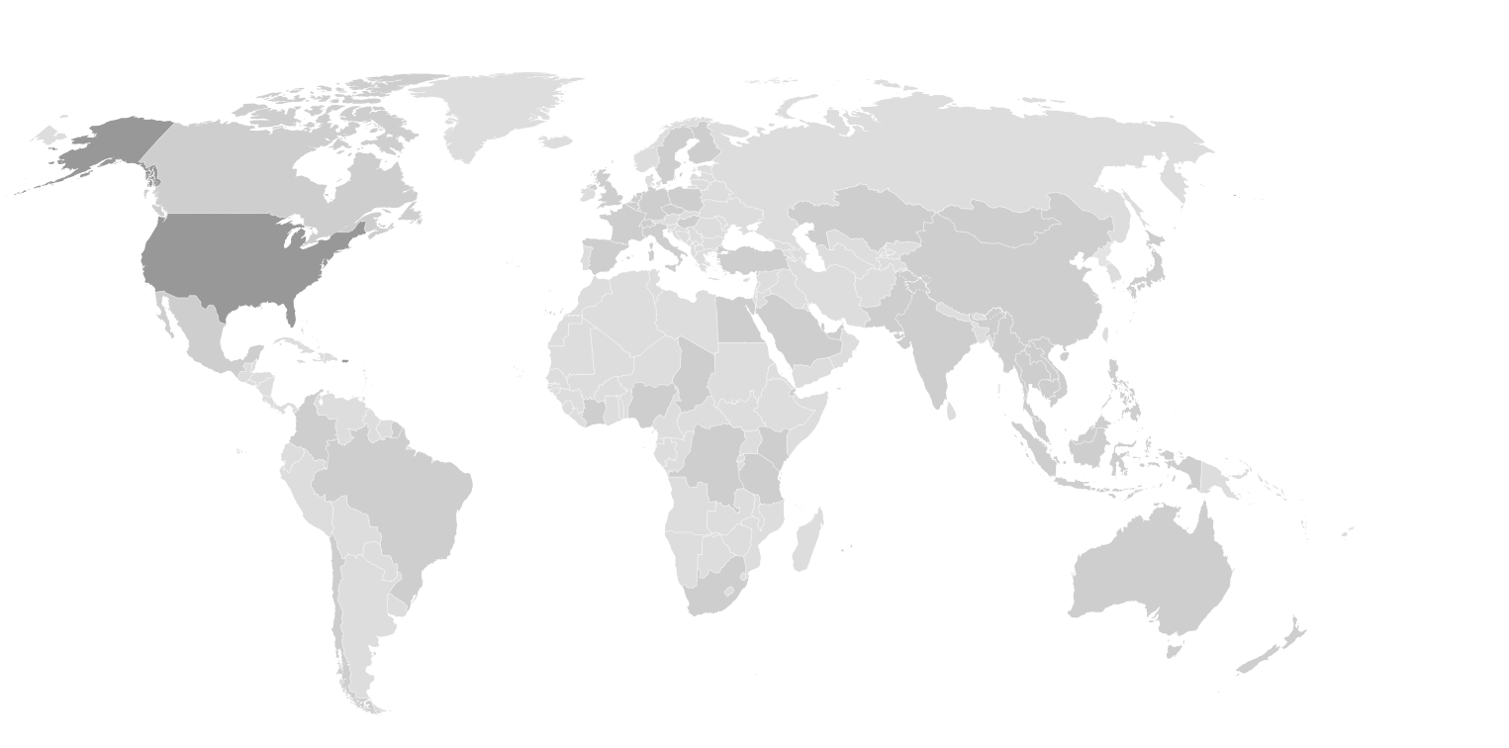
Ruijie Global Service Capacity Overview
50+
Offices Globally
8 R&D Centers
Germany
Britain
Poland
France
Hungary
the United States
Spain
Italy
Türkiye
Japan
20000+ Partners
Pakistan
100+
Tech Specialists
Morocco
Egypt
UAE
Thailand
Hong Kong, China
Mexico
India
Vietnam
Saudi Arabia
Malaysia
Philippines
Singapore
Indonesia
Colombia
90+ Countries and Regions
of Business Coverage
Brazil
Subsidiary Company
Peru
（not mark all on the figure)
Business Coverage
(not mark all on the figure)
Australia
10000+ Knowledge Case
Chile
South Africa
Spare Parts Warehouse
Global Tech Support
Partner Capacity Building
Various Warranty Services
3 Self-Service Platforms with 24*7 Support
24*7 Live Chat Service with Multi-channel Access
12 Instant Communicate Hotlines
World-wide Onsite Support Service
Multilingual Tech Support
Free Basic Warranty
Ruijie Career Certificate
22 Local Spare Parts Platform
Ruijie/Reyee Product Training
R-Care+ Service with 24*7 Tech Support and High Priority RMA
5 Common Scenario-based Solution
Rujiie Official Instructor Certificate
Optimize Service Package

Slide 5
Remote Technical Support Overview
Online Service
Self-service Channel
Fault Reporting Channel
Problem Handling
Problem Escalation
Problem Solved
Level1 Support
Level2 Support
Visual Monitoring
End
User
Fault Acceptance
L2 Specialist
Hotline
Live Chat
Satisfaction Survey
Technical Consultation
VIP Service
Official Web
RITA Robot
Satisfaction Follow-up
Partners
Case Portal
Service Arrangement
Level3 Support
Feedback and Suggestion Analysis
Community
Repair/Spare Parts Acceptance
R&D
Multiple Entrances
Visualized Process
End-to-end ITR Process
Multiple Service Platforms
Spare Parts Delivery Service
Multiple platforms help you access Ruijie technical support

Slide 6
Service Support System- Global Service Hotline
Access instant communication through world-wide service hotline for consultation freely.
* Hotline service is available in local business hours (Warranty: R-Care Service)
* Spanish service operates within the business hours of GMT-6.
Europe
English Speaking Service
Asia-Pacific
(+852)800 969 178
* The hotline is available for all European and other countries .
English Speaking Service
Philippines：(+63)180 013 220 501
Indonesia：(+62)800 150 3096
Malaysia：(+60)180 081 3784
Thailand： (+66)180 001 4687
China Hong Kong：(+852) 800 969 178
Vietnam: (+84) 180 081 60
* The hotlines are available for all Asia-Pacific countries.
Americas
META-UK
English/Spanish Speaking Service
English Speaking Service
Mexico: (+52)800 461 0659
Brazil: (+55) 800 042 007
* The hotline is available for all American countries.
Türkiye：(+90)800 621 2545
Saudi Arabia： (+966) 800 891 2085
United Arab Emirates: (+971) 800 035 704 612
* The hotline is available for all META-UK countries.
Please refer to the link for latest update:
https://www.ruijienetworks.com/support/hotline

Slide 7
Service Policy Overview

Slide 8
Product Warranty - Global Services Policy
Warranty Start Date
Proved customer’s invoice date
Warranty start date under the sales contract
Not more than 90 days after original shipment by Ruijie Networks if none of the above is available.
Warranty End Date
Thirty-six (36) months
90 CD / Invoice date
36 months
Services provided within warranty time
Warranty
Start
Remote Technical Support
Hardware Support
Software Support (OS / Firmware)
Hotline & Live chat
9*5 (Local business time)
Return for Repair(RFR)
By Ruijie Networks
One-to-One Replacement
* By VAD partners
Software Update:
Up to EOS+2 years
Partners or customers can download the latest version of firmware and software from the official website
Self-service Support:
RITA Robot, Official Web, Community…
24*7 Services
Remote troubleshooting, location, analysis, and confirmation of fault solutions.
Ruijie will ship replacement product after confirm the RMA request.
There is no delivery commitment date, which may vary based on customer location.

Slide 9
Product Warranty - Global Services Policy Summary
For Enterprise Distribution entry-level products purchased from Ruijie after February 1st, 2024, now they feature a unified RMA support service, offering One-to-One Replacement Service.
For Enterprise Distribution middle and high-end products purchased from Ruijie after February 1st, 2024, Ruijie will provide a Return For Repair service to customers.
Note：Ruijie provides local spare parts warehouse delivery services in UAE, Saudi Arabia, Türkiye, Thailand, Indonesia, and Vietnam to further improve repair efficiency, and more countries/regions will update continually.
Please kindly refer to the following website for more service policies:
https://www.ruijienetworks.com/support/servicepolicy
Notes:
Ruijie Reyee and Consumer Product Warranty Summary (ruijienetworks.com)
Ruijie Enterprise Distribution Product Warranty Summary (ruijienetworks.com)

Slide 10
Product Warranty for 6 Early Bird Countries
Free Warranty RMA upgrade policy for 6 Early Bird Countries Gold and Silver Channel Partners.
Upgrade policy Period: Starts from April 1st, 2024 to December 31st, 2024. Ruijie provides free upgrades within the basic warranty period.
Customers: Gold and Silver Channel Partners
Country/Region: UAE, Saudi Arabia, Türkiye, Thailand, Indonesia and Vietnam
Available Products: Ruijie Enterprise Distribution mid and high-end products which are sold-out by VAD in 2024.
Products Lines | RMA Policy (Before the upgrade) | **Free Warranty RMA Upgrade Policy
Enterprise entry-level products | One-to-One Replacement Service *By VAD partners | No Upgrade
Enterprise mid and high-end products | Return for Repair (RFR) *By Ruijie Networks | *9x5xNBD-Shipment AHR *By Ruijie Networks
Note: NBD-Shipment=Next Business Day shipment, no committed delivery SLA;
How to obtain warranty RMA upgrades service, please contact the Ruijie post-sales team or TAC team.
Notes:
Advance hardware replacement service is provided after a customer device is judged by Ruijie to have a hardware faulty. The customer should send the faulty part back to Ruijie' s designated receiving point within 15 working days after receiving the spare parts to be replaced from Ruijie.

Slide 11
Certification for Post-Sales Engineers
Improve skills for more customers
Professional Certification
Improves the general technical capacity of engineers
RSE Certification
Provide a series of products + solutions + troubleshooting training, improving Ruijie product capabilities of engineers
Instructor Certification
Develop the capacities of lecturers and transfer the capacities to more engineers
Senior Ability
⭐⭐⭐
RSE- Enterprise Troubleshooting
RSE- Reyee Troubleshooting
RCI- Reyee Instructor
RCI-Enterprise Instructor
Trainer Ability
Intermediate Ability
⭐⭐
Hotel
(Cloud-based)
Hotel
(AC-based)
Hotel
CCTV
Manufacture
Office
RSE- Enterprise Solution
RSE- Reyee Solution
Junior Ability
⭐
RSE- Enterprise Product
RSE- Reyee Product
RSE- Security
Common Basic Ability
RCNP Ruijie Certified Network Professional
RCNP-RS
RCNA Ruijie Certified Network Associate
RCNA-RS
RCNA-WLAN
Knowledge
Solution/Scenario
Product
Cookbook
Troubleshooting
FAQ
How To
Certifications | RCNA | RCNP | RSE-Technical |  |  | RCI-Instructor
 |  |  | Junior Ability | Intermediate Ability | Senior Ability | RCI-Reyee | RCI-Enterprise
Target Partner | All Ruijie Partners | All Ruijie Partners | Register Partner | ASP/ Silver | ASP/ Gold | Reyee VAD | Ruijie VAD
Training Form | Online (E-learning/YouTube) | Online (E-learning/YouTube) | On-site/Online (E-learning) |  |  | Online (E-learning) | Online (E-learning)
Exam Form | Online(E-learning) | Offline(VUE, paid exam) | Multilingual online exams |  |  | Technical certificate +TTT learning+ defense
Period of Validity | 2 Years | 3 Years | 2 Years
Level Up Rules | No skipping allowed

Slide 12
Product Warranty for Partner Benefit
Partner Level | Business | Silver | Gold
Technical Support & Service
Priority Technical Support | × | YES | YES
Expert Hotline* | × | YES | YES
Local Spare Part Warehouse* (15CD RMA) | YES | YES | YES
Local 9x5xNBD-Shippment (NBD AHR)* | × | YES | YES
POC Priority Support | × | YES | YES
Partner Enablement
Local Free Training Lab** | × | YES | YES
*Support Country/Region: UAE, Saudi Arabia, Türkiye, Thailand, Indonesia and Vietnam
**Support Country/Region: UAE, Saudi Arabia, Türkiye, Thailand, Indonesia, Vietnam, Hong Kong, Brazil, Mexico, Spain
Notes:
Hotline Phone Number: https://www.ruijienetworks.com/support/hotline
All signed GP/SP provide phone number or email to service team, to identify them as VIP automatically and provide expert service.

Slide 13
Premium Services

Slide 14
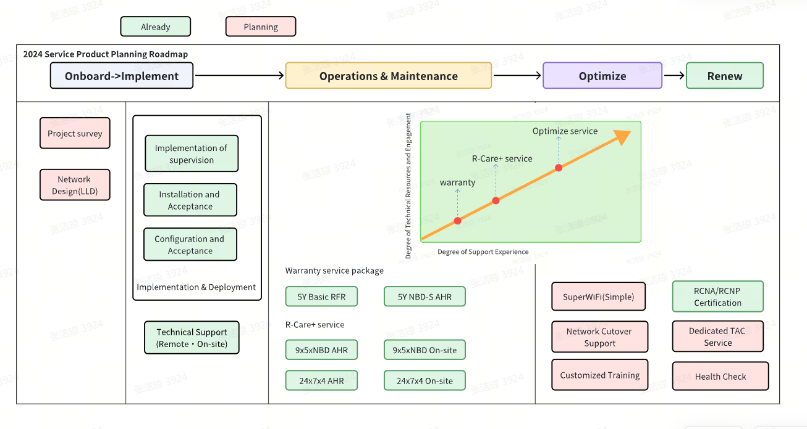
Premium Services
Ruijie Premium Service Mapping to Customers’ business Lifecycle Stage

Slide 15
Premium Services Implementation
Onboard->Implement
Ruijie offers Implementation and Technical Support services to ensure project security and reliability in construction, expansion, and transformation, supporting smooth and efficient project delivery and critical operations for customers and partners.
Ruijie provide configuration for customer devices during network setup, expansion, or modification to ensure compliance with customer’s network needs and requirements.
Ruijie aids in installing and deploying its devices as per specifications, ensuring quality in all scenarios.
Hardware Installation
Technical Support
Project Supervision
Project site survey
Installation and Acceptance
Network
Configuration
Device deployment and planning
Configuration and Acceptance
Ruijie offers advanced project supervision, including management services and technical support from managers.
Ruijie provide technical support for partners to ensure the projects and critical operations complete successfully.
Implementation of supervision
Remote & on-site technical support
Project consultation

Slide 16
Premium Services Maintenance
Operations & Maintenance
Your mission-critical network requires 24x7x365 attention and needs the backing of R-Care+ for Ruijie support services.
R-Care+ provides essential support entitlements to ensure business continuity, featuring 24x7 TAC, NBD, 4H AHR and onsite service support for uninterrupted network operations.
Note:
RFR：Return for Repair
AHR：Advanced Hardware Replacement
NBD：Next Business Day
9*5*15CD-S：15 Calendar Day Shipment
Notes:
Advance hardware replacement service is provided after a customer device is judged by Ruijie to have a hardware faulty. The customer should send the faulty part back to Ruijie' s designated receiving point within 15 working days after receiving the spare parts to be replaced from Ruijie.

Slide 17
Premium Services Maintenance
Operations & Maintenance: 5Y Warranty Service Package
Scenario 1: Customer Requires a Longer Warranty Period
Item | 9x5x15CD-S Basic RFR Service （Extended 2yrs） | 5Y Basic RFR Service Package | 5Y NBD-S AHR Service
Service Specifications | 1）Remote technical support: 9x5 local time 2）9x5x15CD-Ship out Basic RFR Service （year by year renewal） | 1）Remote technical support: 9x5 local time 2）9x5x15CD-Ship out Basic RFR Service （5yrs service package） | 1）Remote technical support: 9x5 local time 2）9x5xNBD-Shipment AHR Service （5yrs service package）
Service Price | Equivalent to 12-15% of the VAD FOB price for the hardware | Equivalent to 7% of the VAD FOB price for the hardware* | Equivalent to 10-15% of the VAD FOB price for the hardware**
Available Products | All products | All Ruijie Enterprise products （the equipment has been delivered for no more than three years） | Ruijie Enterprise Distribution mid and high-end products, such as CS85/86/88 Series And AC series, ect. (purchased in 2024)
Benefits :
Safeguarding customers’ long-term service investment with Price break
Continuous service revenue for VAD partners
*Country/Region: UAE, Saudi Arabia, Türkiye, Thailand, Indonesia, Vietnam, China Hong Kong, Brazil, Mexico and Spain
**Country/Region: UAE, Saudi Arabia, Türkiye, Thailand, Indonesia, Vietnam

Slide 18
Premium Services Maintenance
Operations & Maintenance: R-Care+ Maintenance Services
Scenario 2: More efficient issue handling and faster delivery of spare parts
Service-level
TAC Response time
Hardware Service time
Advance Hardware Replacement SLA
9x5xNBD
Standard AHR Service
24x7x30 min
(software & hardware)
9x5 (excluding holidays)
After Ruijie confirms the RMA requirements, the spare parts will be delivered to the customer's site within SLA (NBD or 4H)
24x7x4
Golden AHR Service
24x7x30 min
(software & hardware)
24x7 (including holidays)
Scenario 3: On-site spare parts replacement and software debugging services are required
Service-level
TAC Response time
Hardware Service time
On-site SLA
9x5xNBD
Standard On-site Service
24x7x30 min
(software & hardware)
9x5 (excluding holidays)
When hardware or software issues can’t be resolved remotely, a Ruijie authorized representative will provide on-site support to resolve the issues.
Ruijie authorized representative and spare parts if necessary will arrive at the designated site of the customer within the SLA.
24x7x4
Golden On-site Service
24x7x30 min
(software & hardware)
24x7 (including holidays)
Notes:
Onsite SLA: Calculation of the on-site response time begins when the initial case has been received and acknowledged by Ruijie and ends with the arrival of the Ruijie authorized representative or closure of the case if on-site is not required.
Please pay attention to that, Ruijie begins to provide on-site operation services after the customer's on-site operation conditions are met.
Ruijie do not promise arrival times for the outlying islands, and the expected transportation and accommodation costs of Ruijie engineers onsite service need users to bear.
eg. Engineer on-site service in Malaysia: East Malaysia and outlying islands areas, the service product price excluding the island accommododation and transportation fees, case by case quotation is required.

Slide 19
Premium Services Maintenance
Operations & Maintenance: R-Care+ Maintenance Services
Ruijie shall use commercially reasonable efforts with Service Level Agreement (SLA) to provide you with hardware replacement services where available.
Travel zones, if applicable, may vary in some geographic locations, as shown in the following table.
Distance from Ruijie-designated support center | 4-hour hardware SLA | Next Business Day hardware SLA
0- 30 Miles (0-50km) | 4 hours | NBD
30–60 Miles (50-100km) | 8 hours | NBD
60–300 Miles (100-500km) | based on actual traffic conditions and other specific conditions | 3BD
More than 300 Miles (500+ km) | based on actual traffic conditions and other specific conditions | based on actual traffic conditions and other specific conditions
Note:
If the user's city is more than 500 kilometers away from Ruijie Hardware Service Center, Ruijie will negotiate with the user to determine the hardware service time based on actual traffic conditions and other specific conditions.

Slide 20
Product R-Care+ Benefit
Deliverable | Product Warranty | R-Care+ Service
Remote Technical Assistance
Priority Access Ruijie TAC | Yes with conditions* | YES
Expert Hotline | Yes with conditions* | YES
Hot line & Live chat SLA | 9x5 | 24x7x365
Hardware Support
Ruijie Case Portal** | YES | YES
Ruijie Local Spare Part Warehouse | Yes with conditions* | YES
Local 9x5xNBD-Shippment (NBD AHR) | Yes with conditions* | YES
AHR and onsite committed delivery SLA | × | YES
Without Additional Charges
Faster Access
Higher Efficiency
*Limited Country/Region and partners: Gold and Silver partners in UAE, Saudi Arabia, Türkiye, Thailand, Indonesia and Vietnam.
Enhance efficiency, reduce costs with instant software access and streamlined asset management and online RMA.
** Ruijie Case Portal Platform：Increase operational efficiency and lower operational costs with immediate online access to software as well as simplified asset tracking and online RMA

Slide 21
Product R-Care+ Experience
Minimize Losses from Equipment Failures
Ruijie partners with you by sharing responsibilities and risks
Preventable
Reduce device’s fault rate and extent device’s service life
Forecast potential risks in the network
Get patches for known bugs
Saudi Arabia, Government customers, Core product, IDC, high business continuity requirements
Secure
Handle daily maintenance problems
Reduce risks during critical operations
Network guarantee for critical moments
Economic
Fixed annual maintenance fee
No extra fee for device’s maintenance and replacement
Safeguarding customers’ long-term service investment returns
Türkiye, Enterprise customer, Core product, Longer warranty period requirements
Faster-recovering
Locate faults and recover business
Massive spare parts warehouses to support your device replacement
Singapore, Large Internet companies, working network, Core products, Faster service, Higher response requirements

Slide 22
Premium Services Optimize
Optimize Service
No. | Service Module | Unit | SLA | Service Content
1 | Man-day Service | Man day | 9*5*NBD | On-site troubleshooting, Network device maintenance, Spare parts replacement support, Network device monitoring and prevention, etc.
2 | Critical moment Onsite Support | Man day | 9*5*NBD 24*7 | On-site Support solution development, device health check, emergency plan development, experts attendance support and Service summary.
3 | Customized Training | Man day | 9*5*NBD | Provide training services according to customer requirements.
4 | Super Wi-Fi Service（Simple） | Per Project | 9*5*NBD | Provide overall solutions such as site survey, planning, implementation, security on duty, critical moment security, on-site technical support, and on-site spare parts for the venue scene to ensure the stable operation of the network during the conference to meet the multi-dimensional business needs of the customer venue.
5 | Health check | Per Project | 9*5*NBD | Use Ruijie health checklist or tools to check the configuration, parameters, and operating status of Ruilie devices, provide suggestions for corrective measures for the checked risky items, and provide a complete inspection report.

Slide 23
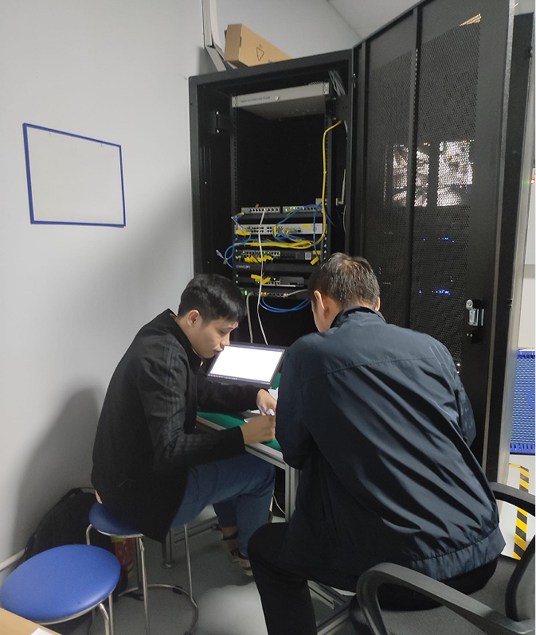
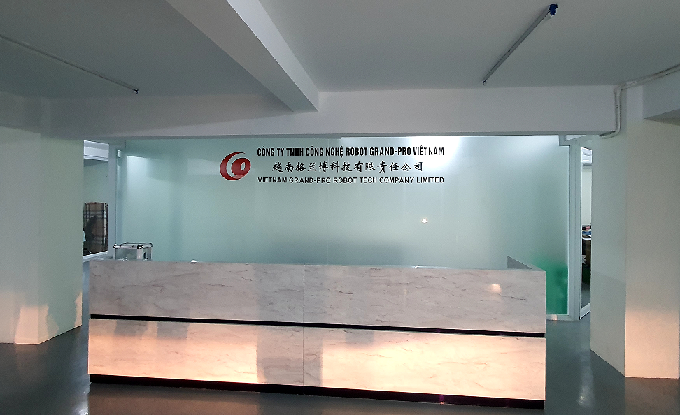
Product Optimize Service Experience
Ruijie provides network access for 3000 + users of the summit, with a wireless experience satisfaction rate of 99% +, ensuring a successful conclusion of the conference
Ruijie provides conference support services for national-level meetings, ensuring uninterrupted network throughout and offering high-quality wireless services.
*This image is derived from open national news and is intended for internal use only. It must not be leaked and is not authorized for commercial use.
Ruijie complete network cutoff within 2 hours, achieve 100% recovery of customer network after cutoff, and meet 100% of new requirements.
*This image is derived from open national news and is intended for internal use only. It must not be leaked and is not authorized for commercial use.

Slide 24
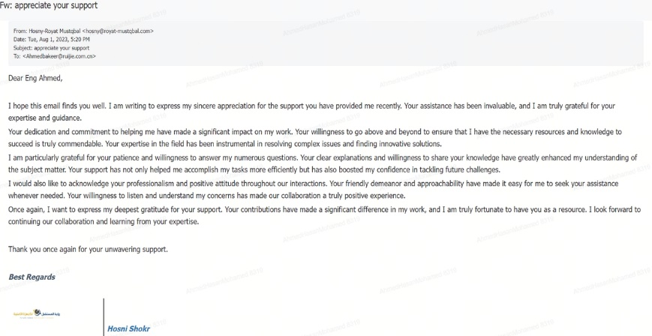
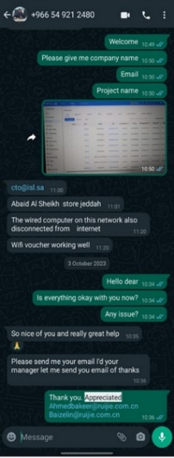
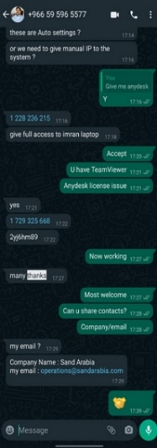
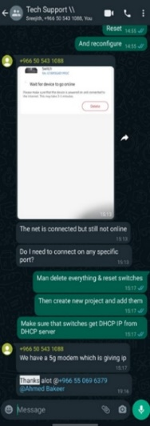
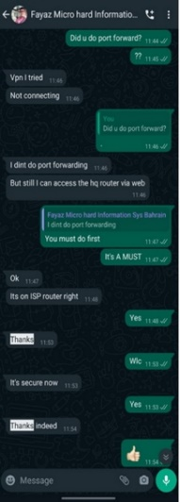
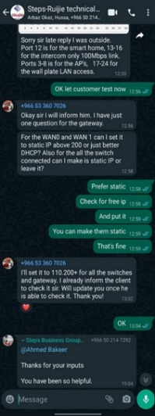
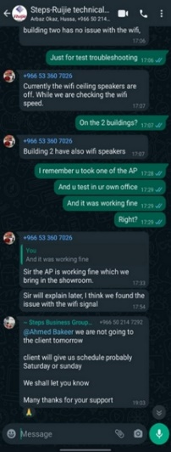
Customer Voices of Ruijie Service Experience
Ruijie Service Value: Provide faster and more professional services for customers
Voices from Customers:
Ruijie regional post-sales engineers have provided customers with more service access channels, more efficient service responses, more professional problem-solving solutions, and more valuable empowerment trainings.
Instance 1 : Excellent Technical Support
Ruijie META-Saudi Arabia Engineer: Ahmed Hasan Mohamed
Keywords: Anytime & Everywhere Access, Efficient, Expert, Mastery of Complex Issues, Proactive, Gentlemanly Patience, Customer Satisfaction

Slide 25
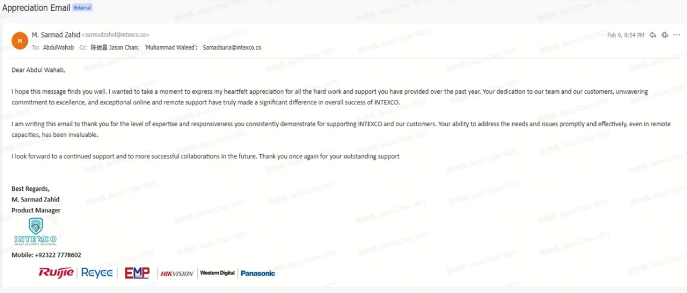
Customer Voices of Ruijie Service Experience
Instance 2 : Professional Problem-solving Solutions
Ruijie META-UAE Engineer: BrandonJoubert
Ruijie META-Pakistan Engineer: AbdulWahab
Keywords: Professional, Dedicated, Reliable, Willing to assist, Unwavering Commitment, Effective in Problem-solving

Slide 26
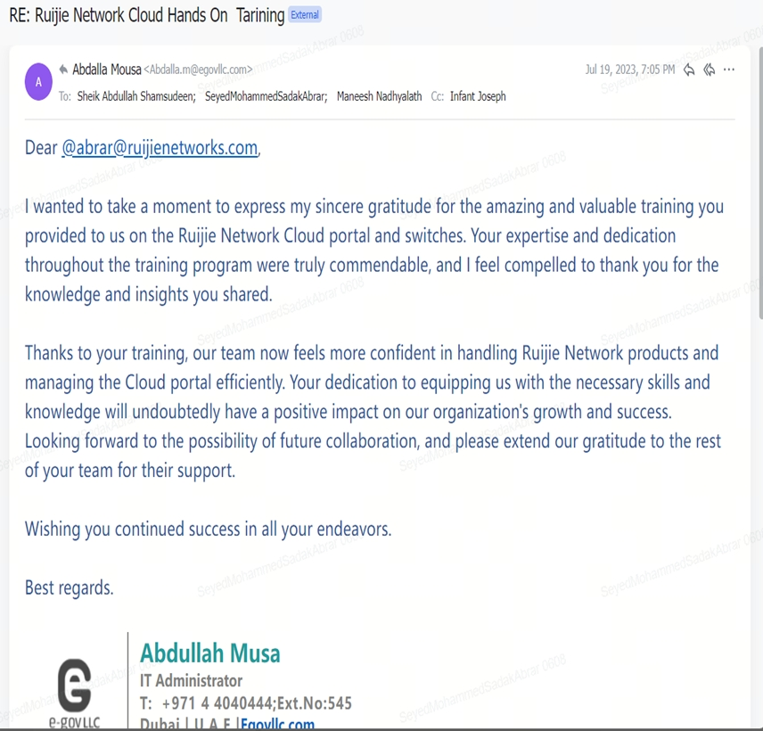
Customer Voices of Ruijie Service Experience
Instance 3 : Valuable Empowerment Training
Ruijie META-UAE Engineer: SeyedMohammedSadakAbrar
Ruijie META-Egypt Engineer: Ahmed
Ruijie META-UAE Engineer: BrandonJoubert
Keywords: Wonderful, valuable, professional, dedicated, growing together with customers, successful

Slide 27
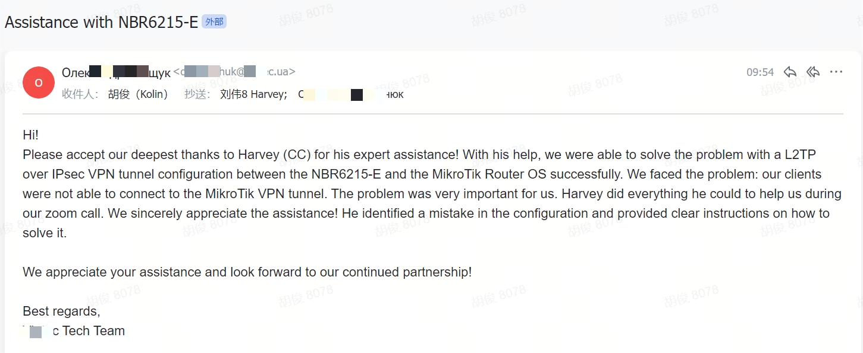
Customer Voices of Ruijie Service Experience
Instance 4 : Efficiently TAC Support
Ruijie TAC Engineer: Harvey
Keywords: Tickets Support, solve issues with customers, fast，effectively

Slide 28
Ruijie Services Benefit for sales-team & VAD partner
Additional increment: Services have the potential to increase market sales and revenue
High profit: Services are more easily able to generate high gross margins and added value compared to traditional hardware
Strengthening customer business relationships : Services bring a second sales chance for business
Continuous service revenue will exceed hardware value through ongoing cost savings and efficiency gains.
Experience:
Saudi Arabia extended warranty P.O. $52,000.
Single renewal for 3 yrs, safeguarding customers’ long-term service investment returns.
Service order amount exceeds core hardware’s
Provide a longer value capture chain for the product strategy through services
IPD
LTC
ITR
Customer lifetime value profit= Product revenue + Service Revenue
R&D investment
Contribution to Profit
EOX
Technology R&D
Product R&D
Go to Marketing
Lifetime Management

Slide 30
What is RMA Return Material Authorization
The main process for handling the repair or replace customer's defective products during warranty or post warranty.
Three types of RMA process to quickly respond to customer's requirements.
Submit RMA Application
Fault & SLA Confirmation
Defective Parts Send Back
Send Defective Parts Back
Replacement Part Ship Out
Warehouse Receipt
Customer Receipt
Warehouse Receipt
Defective Parts Repaired
These Two Steps Operated By Local ASP
Defective Parts Sent Back
Replacement Part Ship Out
N
Y
Repaired Part Ship Out
Replacement Part Ship Out
Customer Receipt
Customer Receipt
Warehouse Receipt
One-to-One Replacement Service
Advance Hardware Replacement
(AHR) Service
Return for Repair (RFR) Service
Provide By VAD
Provide By Ruijie

Slide 31
RMA Process Introduction: One-to-One Replacement Service
Key Points:
ASP or end user submits RMA application.
ASP will send replacement parts to end user within 15CD once get defective parts.
ASP shall outbound replacement parts in CSM system as well.
ASP/ Customer
Submit RMA Application
Fault & SLA
Confirmation
in 1BD
Warehouse
from VAD
Transportation
Customer
Defective Parts
Repaired Parts
The case portal website is following:
https://www.ruijienetworks.com/support/caseportal

Slide 32
What Happened If Current ASP “No Stock”?
Submit RMA Application
Fault & SLA Confirmation
Defective Parts Send Back
The Different
Operation by ASP
Warehouse Receipt
In Stock/ Substitute
N
Local Warehouse
N
China Central Warehouse
Select “no stock” in CSM
Other ASPs
N
Y
Y
N
In Stock/ Substitute
Replacement Part Ship Out
In Stock/ Substitute
Customer Receipt
Y (SLA: 2BD ship out)
Y
SLA: 15CD ship out

Slide 33
RMA Process Introduction: Return for Repair (RFR) Service
Key Points:
Customers send defective parts to Ruijie first.
Ruijie sends repaired parts back to customer within 15CD once received defective parts.
If the defective parts can’t be repaired, Ruijie will provide a replacement model.
Application submit and confirm
Repair Center
Warehouse Receipt
Customs
Customs
Customer
Defective Parts
Repaired Parts
Notes:
Expenses related to shipping defective parts back to Ruijie shall be undertaken by the customer: including local transportation, local customs clearance on the customer side, and international logistics from the customer to Ruijie.
Expenses related to shipping repaired/replace parts back to the customer shall be undertaken by Ruijie: including local transportation, local customs clearance on Ruijie side, and international logistics from Ruijie to the customer.
For the country in which Ruijie have local warehouses, customer can send defective parts to Ruijie's local warehouses (such as Turkey, UAE, Saudi Arabia, Indonesia, Thailand and Vietnam, and more countries will update continually), Ruijie will provide repaired/ replacement parts within SLA.

Slide 34
RMA Process Introduction：Advance Hardware Replacement (AHR) Service
Key Points:
Ruijie will send good parts within SLA first once the application is approved.
Customer shall send defective parts to Ruijie local warehouse or Ruijie picks up defective parts from the customer within 15CD after the customer received good parts.
Submit RMA Application
Fault & SLA
Confirmation
Warehouse
Transportation
Customer
Defective Parts
Repaired Parts

Slide 35
Premium Services Maintenance
Operations & Maintenance: Ruijie spare parts warehouse address
Country | City | Warehouse Address
Indonesia | Jarkata | Jl. Dr. Saharjo No.45, RT.1/RW.7, Manggarai, Kec. Tebet, Kota Jakarta Selatan, Daerah Khusus Ibukota Jakarta 12850
Thailand | Bangkok | 130 Ladkrabang Industrial Estate, Lamplatiew, Ladkrabang, Bangkok 10520
Vietnam | Ho Chi Minh | Warehouse No. 5, No. 754/8 Tan Ky Tan Quy Street, Binh Hung Hoa Ward, Binh Tan District, Ho Chi Minh City, Viet Nam
Singapore | Singapore | No.8 Bulim Avenue, Supply Chain City Fushionaris Warehouse R1-05 Singapore 648166
Malaysia | Shah Alam | YCH Logistics (M) Sdn Bhd ENTRANCE: BLOCK A, UNIT 4 END RAMP Mapletree Shah Alam Logistics Park No. 14, Persiaran Perusahaan, Block A Unit 1, 2, 3 & 4, Seksyen 23 40300 Shah Alam
Malaysia | Johor | No. 20, Jalan Perjiranan 4/5, Bandar Dato Onn, 81100 Johor Bahru, Johor, Malaysia
Philippines | Manila | 9009, Cepeda St., Concepcion uno, Markina City. 1807 Philippines
Saudi Arabia | Riyadh | Al Aiq, Al Fayha, Riyadh 14253 Saudi Arabia
Turkey | İstanbul | Company name: BDH Bilişim Destek Hizmetleri Address: Bağlarbaşı, Cemal Bey Cd. No:110, 34844 Maltepe/İstanbul
UAE | Dubai | Aramex Emirates L.L.C ：Aramex fulfillment centre Dubai South 0000 Dubai UNITED ARAB EMIRATES
Hong Kong, China | Hong Kong | Rm 105, 1/F, Liven House, 61-63 King Yip Street, Kwun Tong, Kln

