Slide 1
2024 Ruijie
Service & Support (V3.0)

Slide 2
Version Information
Last Edit Date | Version | Update By
Jan 23rd, 2024 | V1.0 | Eureka
Apr 27th, 2024 | V2.0 | Eureka
Aug 20, 2024 | V3.0 | Joan

Slide 3
About Ruijie Networks Service
As an ICT infrastructure and solution provider, Ruijie Networks has taken service as its foundation since its inception. Ruijie Networks has established a set professional service system in the service network, service processes, service staff, and service tools based on practical experience to help customers access high-quality service.
Ruijie Networks will improve the service management system and service product continually based on customer’s requirements with a forward-looking sight.

Slide 4
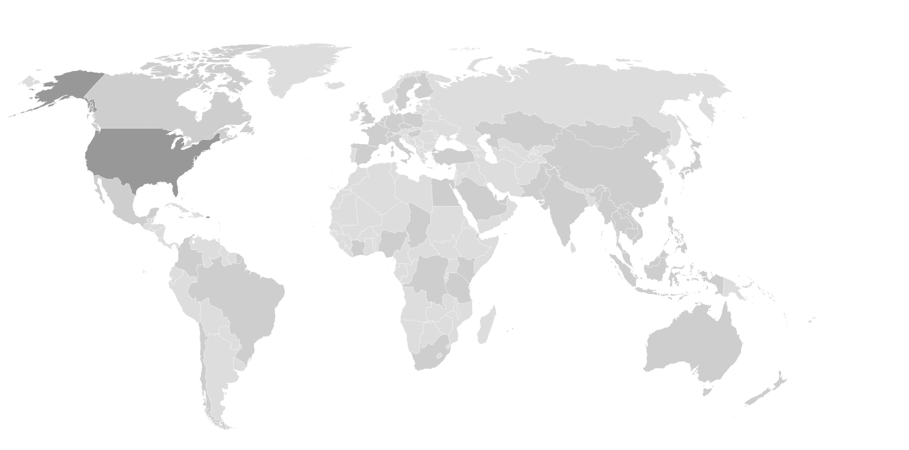






Ruijie Global Service Capacity Overview
50+
Offices Globally
8 R&D Centers
Germany
Britain
Poland
France
Hungary
the United States
Spain
Italy
Türkiye
Japan
20000+ Partners
Pakistan
100+
Tech Specialists
Morocco
Egypt
UAE
Thailand
Hong Kong, China
Mexico
India
Vietnam
Saudi Arabia
Malaysia
Philippines
Singapore
Indonesia
Colombia
90+ Countries and Regions
of Business Coverage
Brazil
Subsidiary Company
Peru
（not mark all on the figure)
Business Coverage
(not mark all on the figure)
Australia
10000+ Knowledge Case
Chile
South Africa
Spare Parts Warehouse
Global Tech Support
Partner Capacity Building
Various Warranty Services
3 Self-Service Platforms with 24*7 Support
24*7 Live Chat Service with Multi-channel Access
12 Instant Communicate Hotlines
World-wide Onsite Support Service
Multilingual Tech Support
Free Basic Warranty
Ruijie Career Certificate
22 Local Spare Parts Platform
Ruijie/Reyee Product Training
R-Care+ Service with 24*7 Tech Support and High Priority RMA
5 Common Scenario-based Solution
Rujiie Official Instructor Certificate
Optimize Service Package
Notes:
今天，锐捷网络已经成为行业领先的网络设备及行业解决方案提供商 。公司拥有8000余名员工，业务覆盖全球90多个国家和地区，合作伙伴2万多家。作为一家重视技术创新科技型公司，锐捷设立了8大研发中心，走出了一条属于自身的自主研发的道路。
With the rapid development of network and communication technology, the network has been integrated into the daily life of people all over the world. This also leads to a huge, fast-growing, unimaginable market.
At the beginning of the 21st century, Ruijie Networks was founded by a group of young people who are determined to change the world with technology and create a world-class brand.
Now, Ruijie has become the Industry-leading Network Infrastructure and solution Provider with more than 8,000 employees and 20,000 partners.Business coverage in 90+ countries and regions. As a technology-based company that attaches importance to technological innovation. Ruijie has built 8 R&D centers, Ruijie has embarked on its own way of independent research and development.

Slide 5
01
Technical Support Resource
02
Training & Certification
03
Warranty Policy and Value-added Service Product

Slide 6
Technical Support Resource

Slide 7











Remote Technical Support Overview
Online Service
Self-service Channel
Fault Reporting Channel
Problem Handling
Problem Escalation
Problem Solved
Level1 Support
Level2 Support
Visual Monitoring
End
User
Fault Acceptance
L2 Specialist
Hotline
Live Chat
Satisfaction Survey
Technical Consultation
VIP Service
Official Web
RITA Robot
Satisfaction Follow-up
Partners
Case Portal
Service Arrangement
Level3 Support
Feedback and Suggestion Analysis
Community
Repair/Spare Parts Acceptance
R&D
Multiple Entrances
Visualized Process
End-to-end ITR Process
Multiple Service Platforms
Spare Parts Delivery Service
Multiple platforms help you access Ruijie technical support

Slide 8
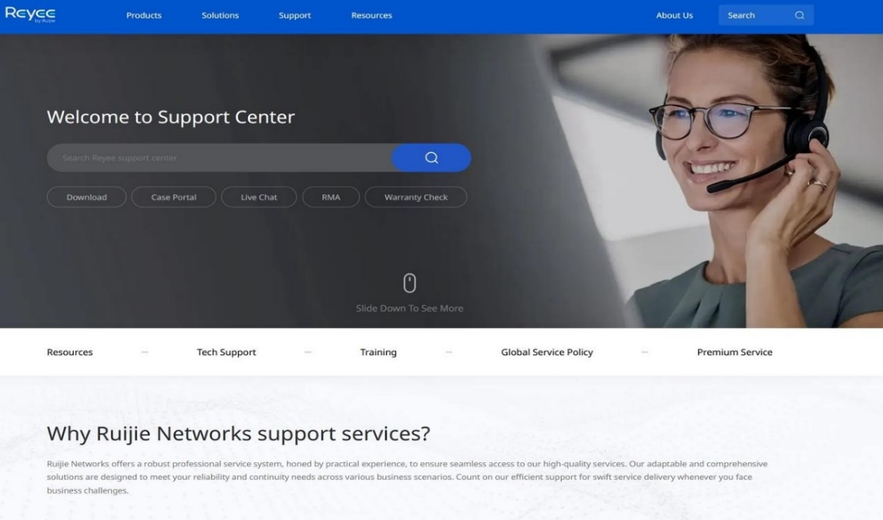
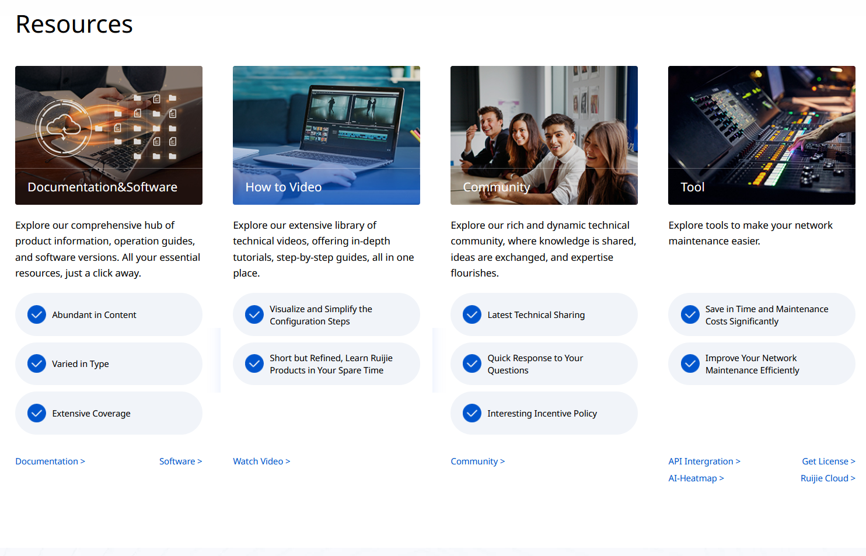
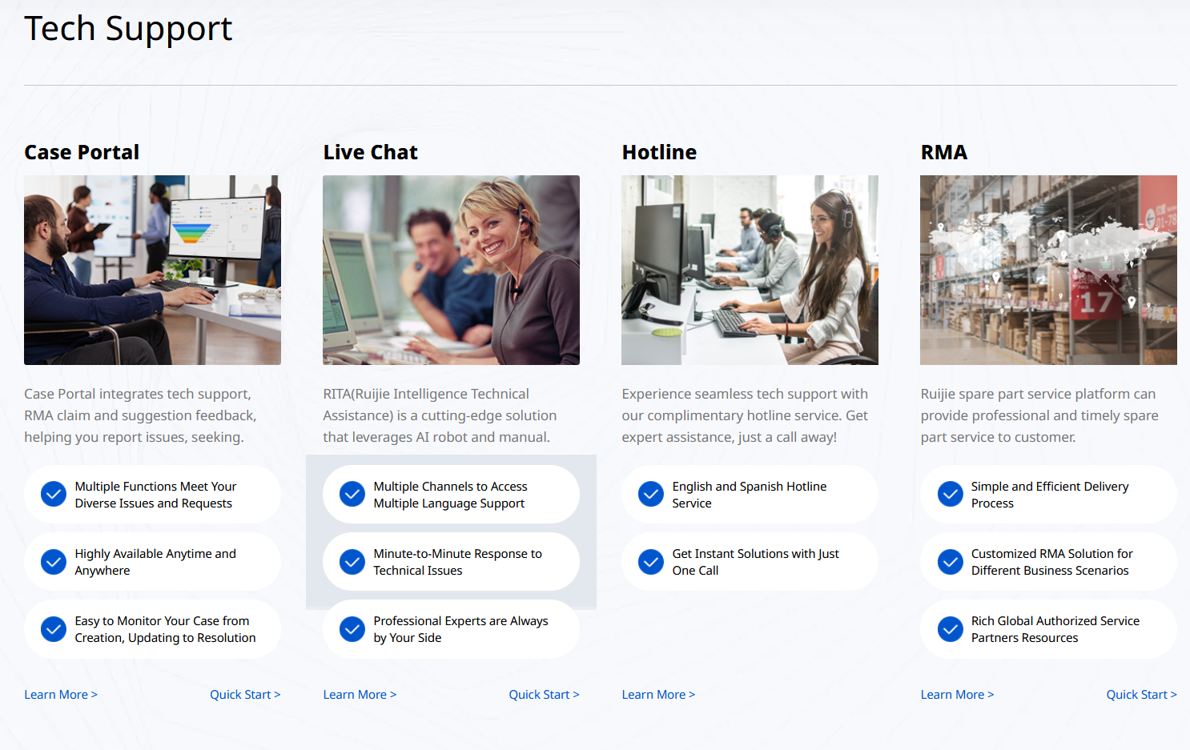
Ruijie Service Platform: Service Portal
Service Portal is an unified support resource index platform to access Ruijie technical support. In-depth service overview and user-friendly design help you know Ruijie services and their highlight values easily.
https://www.ruijienetworks.com/support
https://reyee.ruijie.com/en-global/support

Slide 9
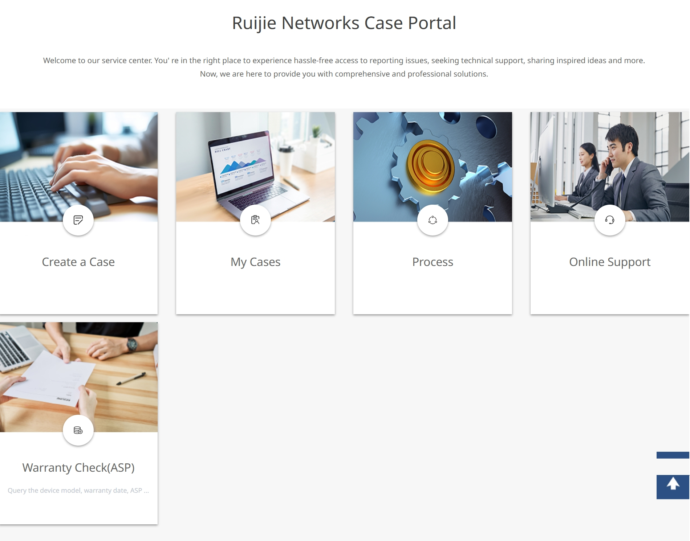
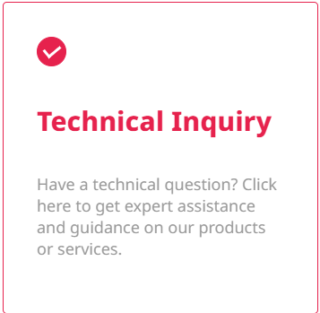
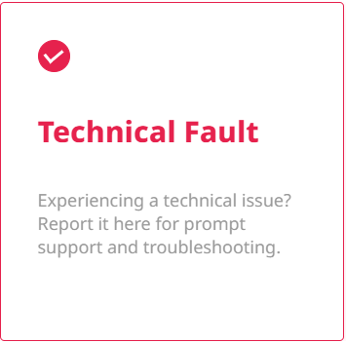

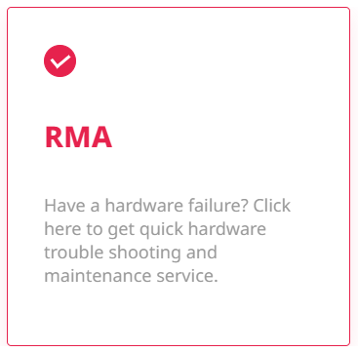
Ruijie Service Platform: Case Portal
Case Portal integrates Tech Inquiry, Tech Fault, RMA Claim and Suggestion feedback, helping customers report issues, seek technical supports and sharing inspired ideas.
24*7 Service
https://www.ruijienetworks.com/support/caseportal

Slide 10
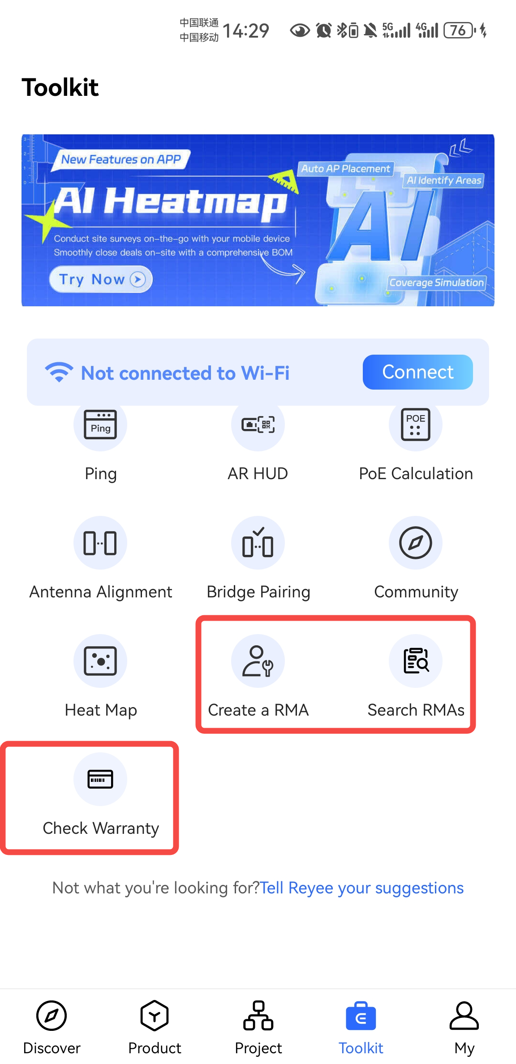
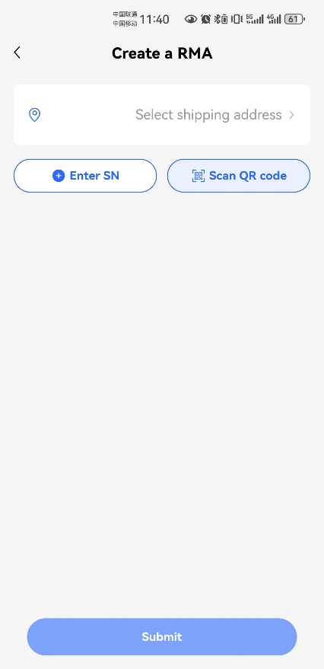
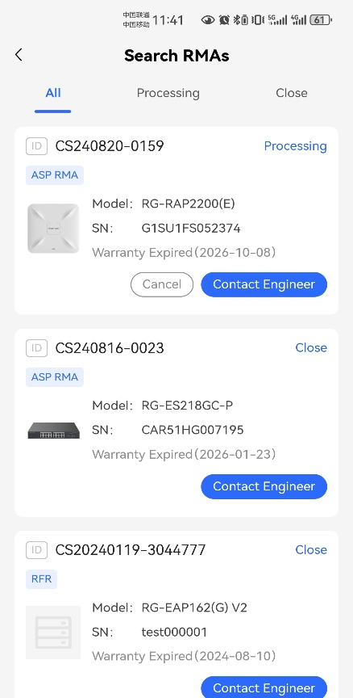
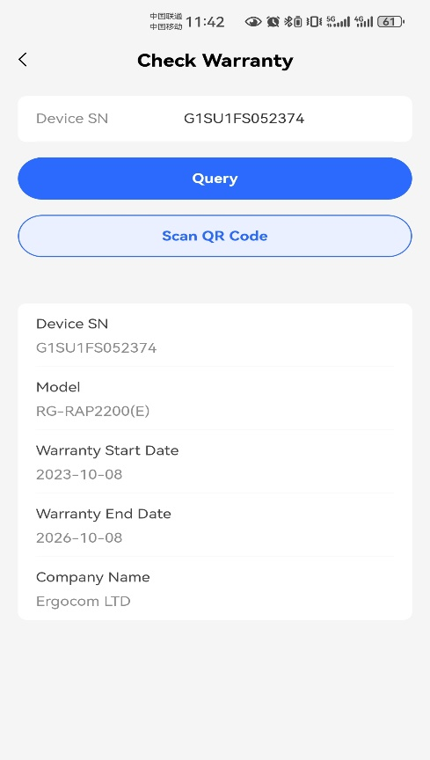


Ruijie Service Platform: Ruijie Reyee App
RMA module in Ruijie Reyee App can process RMA business conveniently, include create RMA, search RMA to check the details process and check warranty by SN.
Download
Ruijie Reyee App
RMA Module
Create a RMA
Search RMAs
Check Warranty

Slide 11
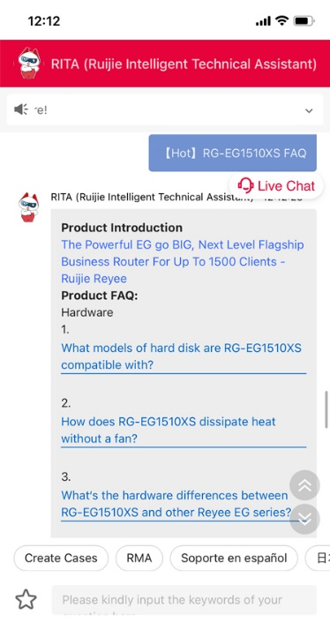
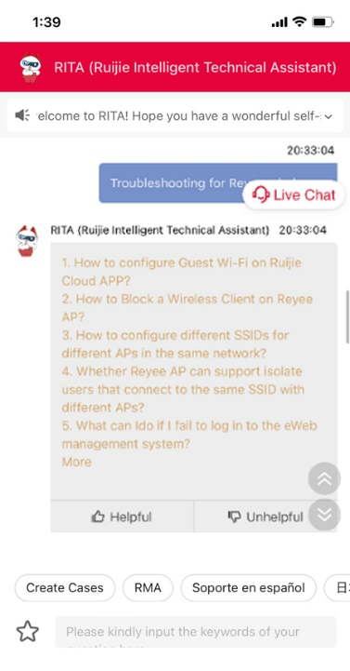
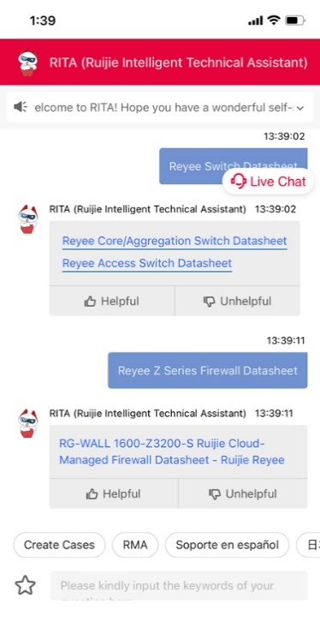


Ruijie Service Platform: RITA-Ruijie Intelligent Tech Assistant
RITA Robot provides 24*7 service for customers, helping customers find the answer by a few clicks in the navigation bar or the chat with RITA.
“
Answer FAQ
Troubleshooting
Product Specification
Pocket Network Expert
”
RITA
Ruijie Intelligent Tech Assistant
https://www.ruijienetworks.com/rita

Slide 12
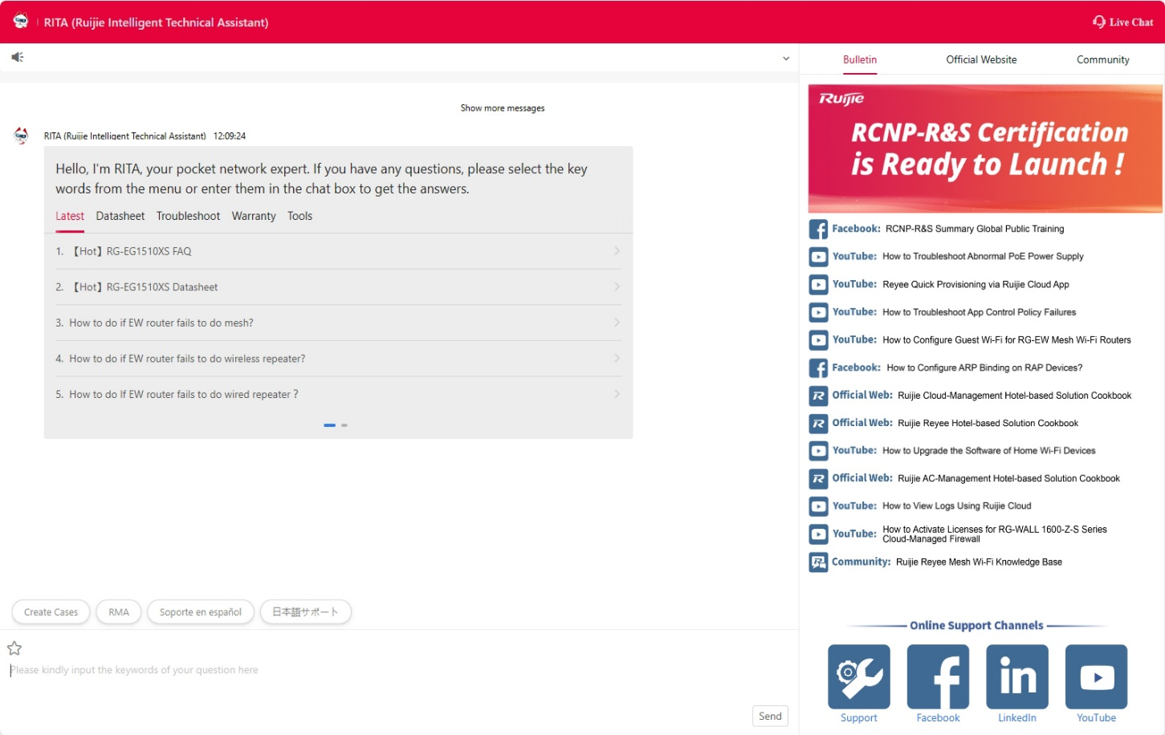
Ruijie Service Platform: RITA-Ruijie Intelligent Tech Assistant
Massive technical resources (technical documents, products specifications, operation videos, troubleshooting guidance…) can be reached with clicks.
3
1
Browse multi-platform with less time consuming
Simple clicks to find answers more precisely
4
2
More diverse display content
Customized tags related with most frequent questions
https://www.ruijienetworks.com/rita

Slide 13
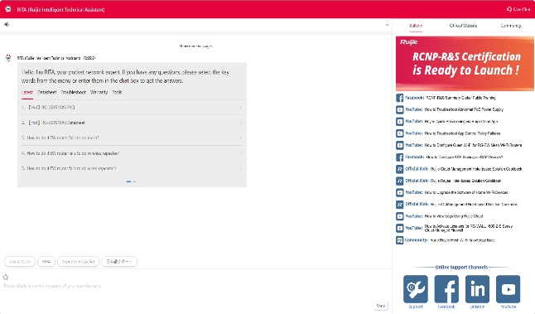

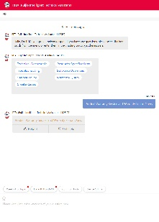
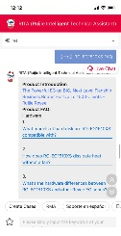

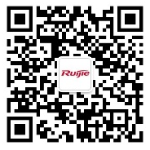




Ruijie Service Platform: Live Chat Support
Ruijie provides online manual service on RITA Live Chat. You can access it through multiple channels (Web, WeChat, WhatsApp, LINE, Facebook and Messenger). Live Chat supports over 130 languages, helping you communicate with Ruijie engineer directly.
Warranty Service(R-Care)
English Service：
9:00 AM to 6:00 PM
(Local time, Monday to Friday)
Spanish Service：
9:00 AM to 6:00 PM
(GMT-6, Monday to Friday)
R-Care+ Service
* Customers may opt for an enhanced warranty package(R-Care+ service), which provides 24*7 access to hotline support and online manual assistance.
Website
WeChat
WhatsApp
LINE
Facebook
Messenger
https://www.ruijienetworks.com/rita

Slide 14





Ruijie Service Platform: Expert Support Channel
We offer free enterprise-level direct expert services to key partners, which further saves you from investing in services.
Support Channel
L1 Support
L2 Support
Technical Consultation
L2 Specialist
End User
Hotline
Live Chat
Case Portal
Service Arrangement
Local Engineer
RMA Spare parts
Website
WeChat
WhatsApp
Enterprise Device SN
Register Partner Account
Partners
Expert Engineer
Direct Access to Expert Support Team
LINE
Facebook
Messenger
Minute-by-minute Response
R&D
Multi-channel Quick Start Service

Slide 15
Ruijie Service Platform: Global Service Hotline
Access instant communication through world-wide service hotline for consultation freely.
* Hotline service is available in local business hours (Warranty: R-Care Service)
* Spanish service operates within the business hours of GMT-6.
Europe
English Speaking Service
Asia-Pacific
(+852)800 969 178
* The hotline is available for all European and other countries .
English Speaking Service
Philippines：(+63)180 013 220 501
Indonesia：(+62)800 150 3096
Malaysia：(+60)180 081 3784
Thailand： (+66)180 001 4687
China Hong Kong：(+852) 800 969 178
Vietnam: (+84) 180 081 60
* The hotlines are available for all Asia-Pacific countries.
Americas
META-UK
English/Spanish Speaking Service
English Speaking Service
Mexico: (+52)800 461 0659
Brazil: (+55) 800 042 007
* The hotline is available for all American countries.
Türkiye：(+90)800 621 2545
Saudi Arabia： (+966) 800 891 2085
United Arab Emirates: (+971) 800 035 704 612
* The hotline is available for all META-UK countries.
Please refer to the link for latest update:
https://www.ruijienetworks.com/support/hotline

Slide 16
Technical Support Specifications
The problems of customers will be classified into 4 level based on the severity. The definition and follow-up specs of every level are shown as below:
Severity Level | Severity Level Description | SLA Period | Issue Tracking Frequency
P4 | Customer consults functions, configuration methods, etc. | 18 CD | ≥ 1 /3BD
P3 | Customers fail to configure their devices or other problems except for P1 and P2 faults. | 18 CD | ≥ 1 /3BD
P2 | 1.The customer’s network is disconnected, or the core business is affected which can’t be recovered in time (30 mins). 2.The actual handling time of P3 fault exceeds 18 days without providing any solutions | 12 CD | ≥ 1 /1BD
P1 | 1.The key customer’s network is disconnected, or core business is affected which can’t be recovered in time (within 30 mins) 2. The actual handling time of P2 fault exceeds 12 days without providing any solutions | 7 CD | ≥ 1 /1BD
Remarks: The Severity Level definition may vary based on the customer’s network complexity and force majeure factors.

Slide 17
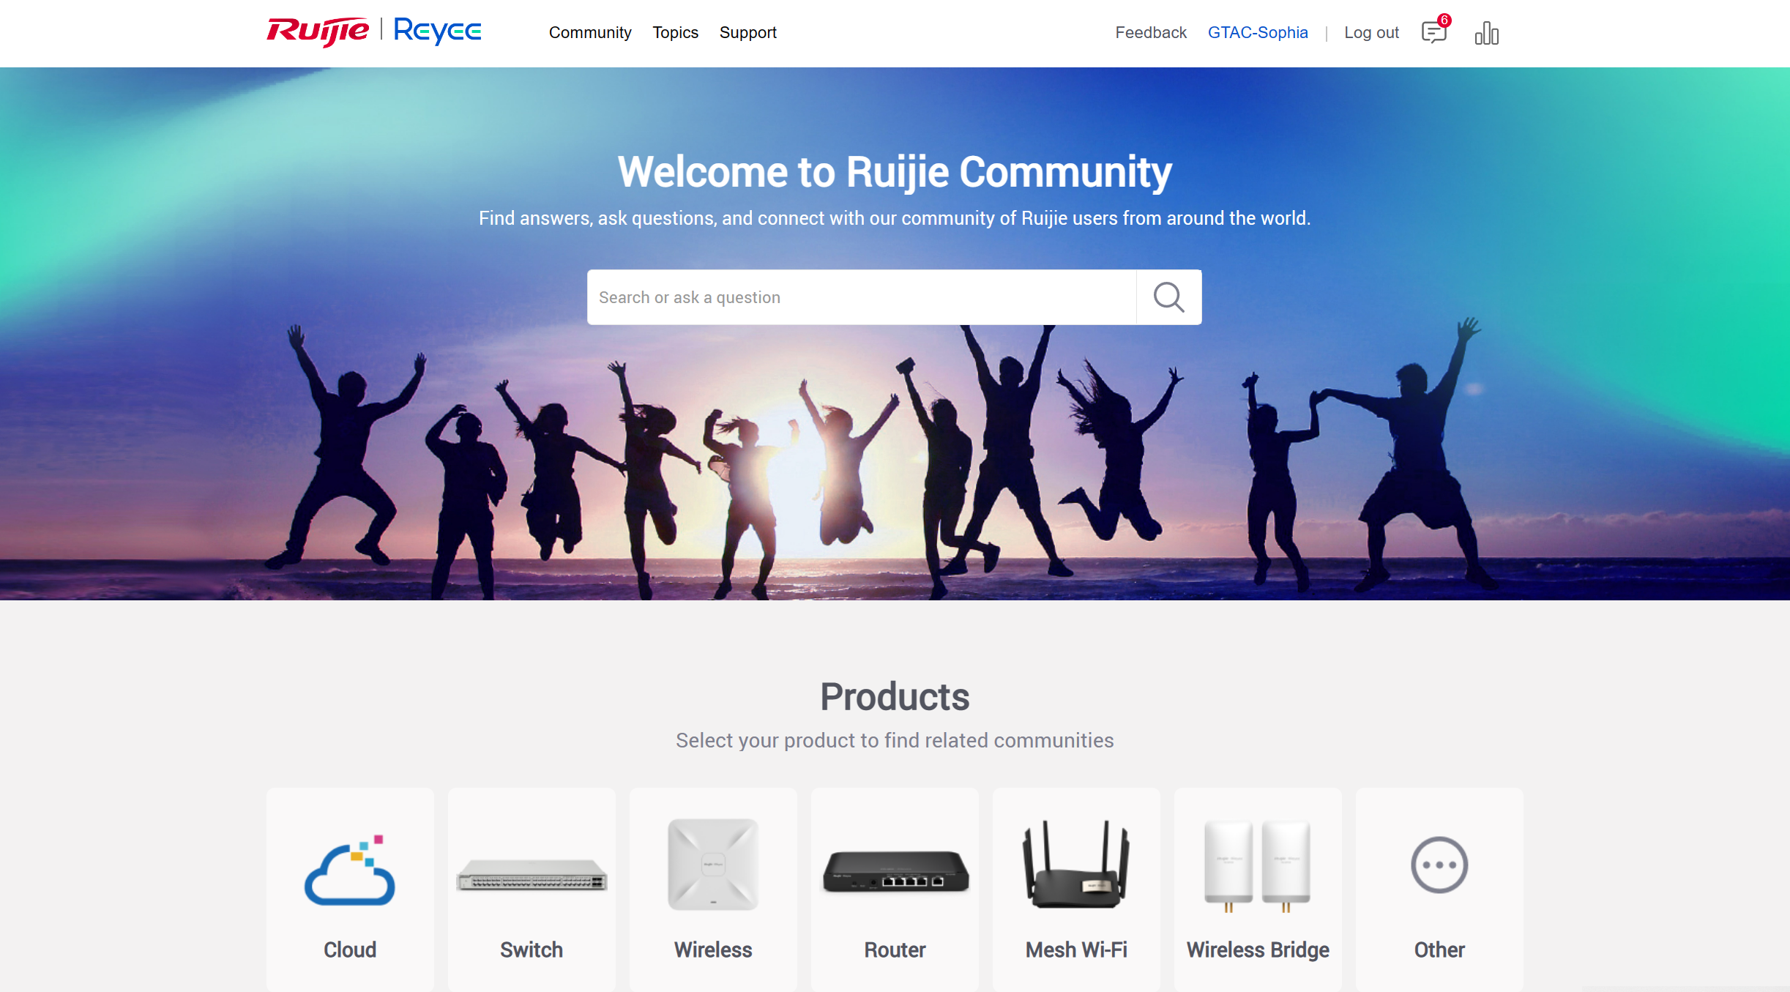


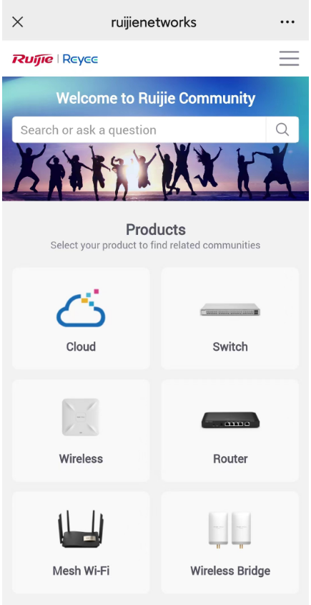




Ruijie Service Platform: Community
Community is an open forum where you can share your opinions, discuss the technical issues and get help from Ruijie engineer and other experts.
1 on 1 Suggestion Feedback
Quick Response to Your Questions
Talk about your requirements with Ruijie product manager
Contact Ruijie engineer for technical support
Latest Technical Sharing
Bountiful Gifts and Rewards
Fit different types terminals
3000+ posts help you catch the trend of Ruijie technology
Join in Community activities to get bountiful gifts and rewards
https://community.ruijienetworks.com/

Slide 18
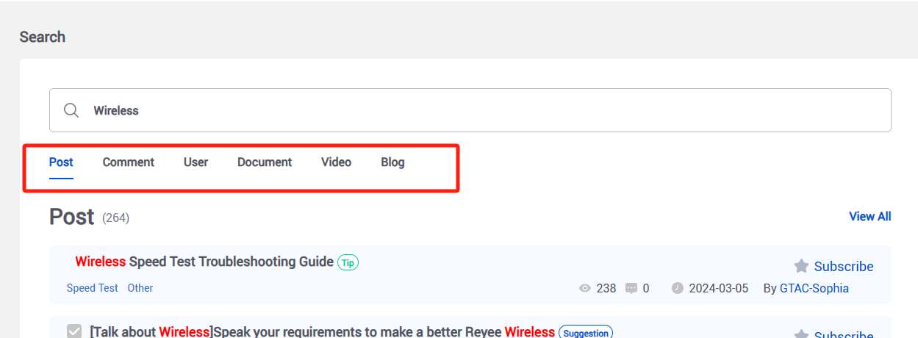
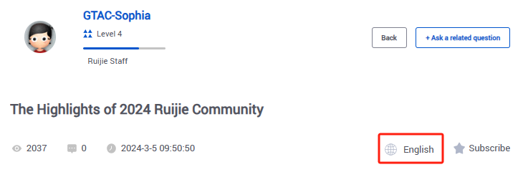

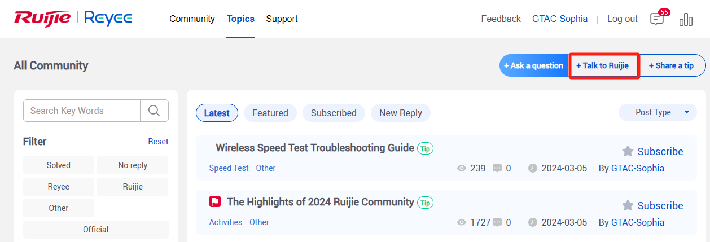
Ruijie Service Platform: Community
A Broader Searching Range
Multi-Languages Auto-translation
Searching range includes Posts, Comments, Users, Documents, Videos, Blogs.
30 languages are supported to translate the whole page of the posts
Incentive Points and Medals System
A New Post type "Talk to Ruijie"
Multiple and attractive points exchange ways and medal list
A public suggestion feedback channel for all customers

Slide 19
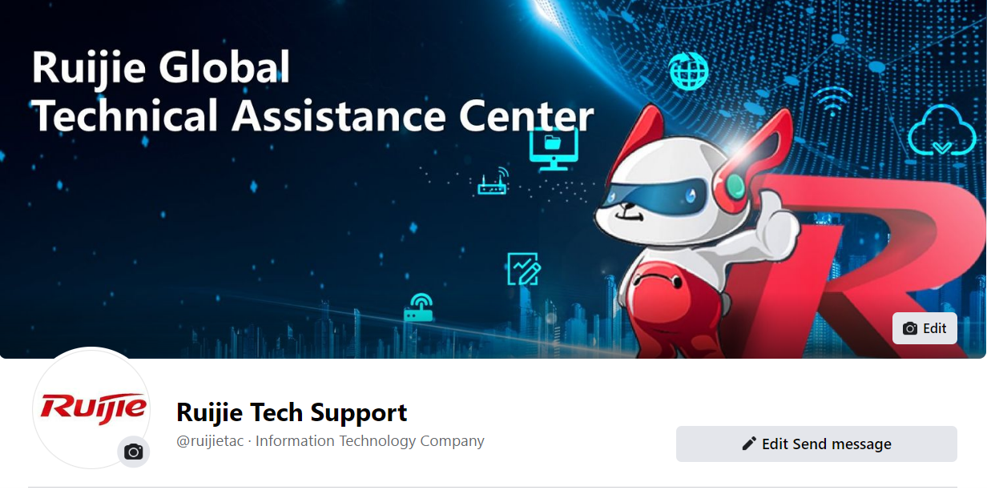



Social Media: Facebook & LinkedIn Page
Get the firsthand information about Ruijie
Ruijie Tech Support shares the firsthand news about technology, training, official activities on the social media.
Access manual service through Facebook page
Chat with Ruijie engineer online by sending message to the public page.
LinkedIn: Ruijie Tech Support
Facebook: Ruijie Tech Support

Slide 20


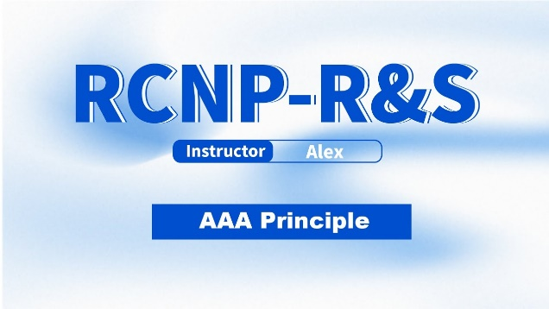


Social Media: YouTube Channel
Latest Ruijie training course
The certified courses and recording videos of public training will be updated here.
Technical videos
Find various configuration guidance in How-to Series
YouTube: Ruijie Technical Support
https://www.youtube.com/c/RuijieTechnicalSupport

Slide 21

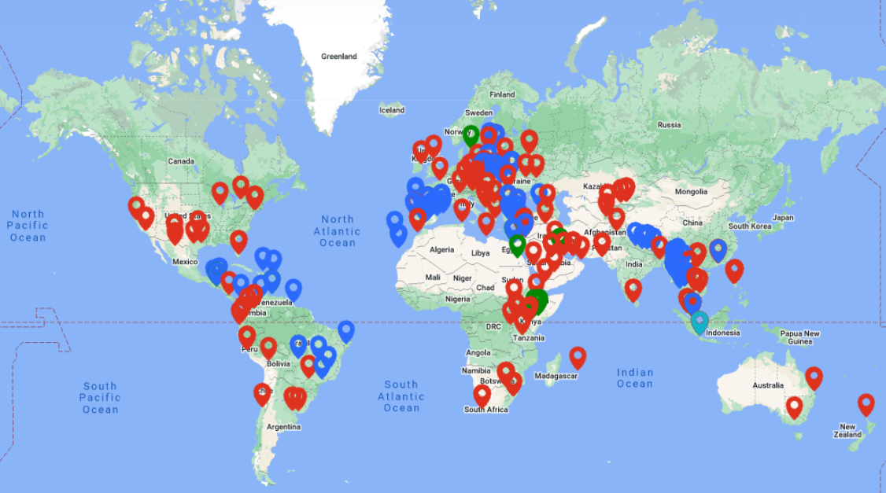
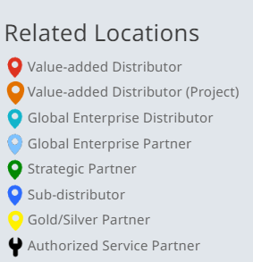
Onsite Support: Authorized Service Partner
Ruijie has world-wide authorized service partners for local technical support to improve service coverage.
https://www.ruijienetworks.com/partner/locator

Slide 22
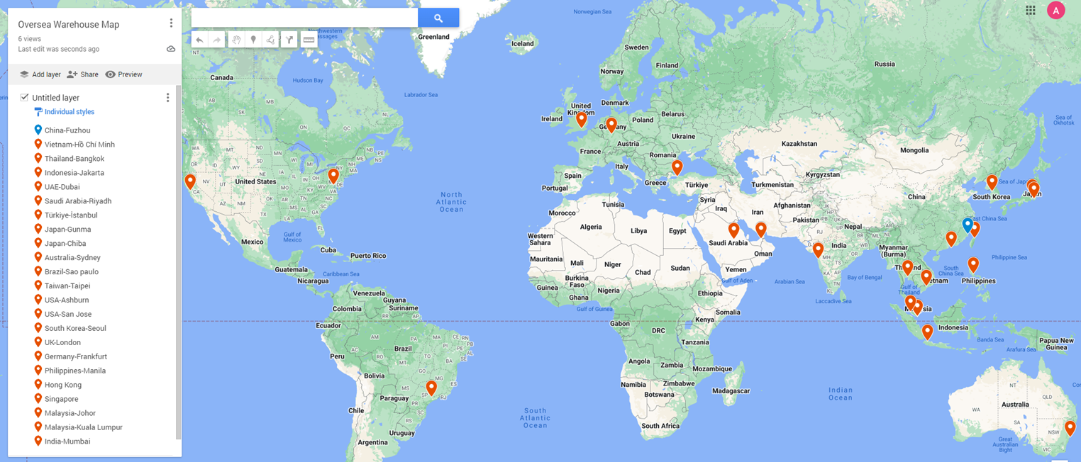
Onsite Service: Spare Parts Service Network Around the World
Spare parts warehouses have been built in 20 countries or regions, providing spare parts services for more than 65 surrounding cities and meet the customer's needs of 4H, ND, NBD and other service SLA based on the actual situation.
Spare parts warehouse (22)
Central spare parts warehouse (1)

Slide 23
Training & Certification

Slide 24
Certification for Post-Sales Engineers
Improve skills for more customers
Professional Certification
Improves the general technical capacity of engineers
RSE Certification
Provide a series of products + solutions + troubleshooting training, improving Ruijie product capabilities of engineers
Instructor Certification
Develop the capacities of lecturers and transfer the capacities to more engineers
Senior Ability
⭐⭐⭐
RSE- Enterprise Troubleshooting
RSE- Reyee Troubleshooting
RCI- Reyee Instructor
RCI-Enterprise Instructor
Trainer Ability
Intermediate Ability
⭐⭐
Hotel
(Cloud-based)
Hotel
(AC-based)
Hotel
CCTV
Manufacture
Office
RSE- Enterprise Solution
RSE- Reyee Solution
Junior Ability
⭐
RSE- Enterprise Product
RSE- Reyee Product
RSE- Security
Common Basic Ability
RCNP
Ruijie Certified Network Professional
RCNP-RS
RCNA
Ruijie Certified Network Associate
RCNA-RS
RCNA-WLAN
Knowledge
Solution/Scenario
Product
Cookbook
Troubleshooting
FAQ
How To
Certifications | RCNA | RCNP | RSE-Technical |  |  | RCI-Instructor
 |  |  | Junior Ability | Intermediate Ability | Senior Ability | RCI-Reyee | RCI-Enterprise
Target Partner | All Ruijie Partners | All Ruijie Partners | Register Partner | ASP/ Silver | ASP/ Gold | Reyee VAD | Ruijie VAD
Training Form | Online (E-learning/YouTube) | Online (E-learning/YouTube) | On-site/Online (E-learning) |  |  | Online (E-learning) | Online (E-learning)
Exam Form | Online(E-learning) | Offline(VUE, paid exam) | Multilingual online exams |  |  | Technical certificate +TTT learning+ defense
Period of Validity | 2 Years | 3 Years | 2 Years
Level Up Rules | No skipping allowed

Slide 25
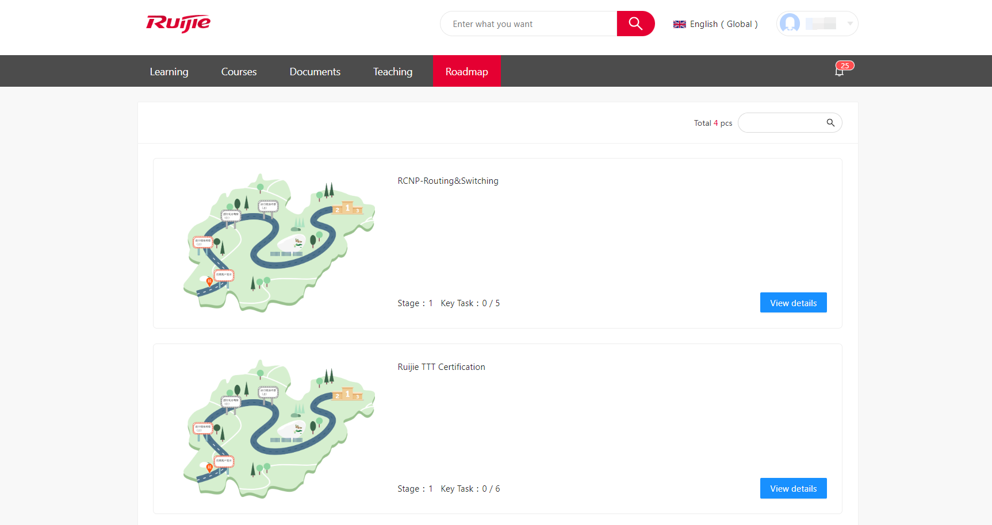
Online Learning Resource: E-Learning
E-Learning is an unified platform for technical study and certification, providing you with Ruijie training videos, materials and so on.
https://elearning.ruijienetworks.com/

Slide 26
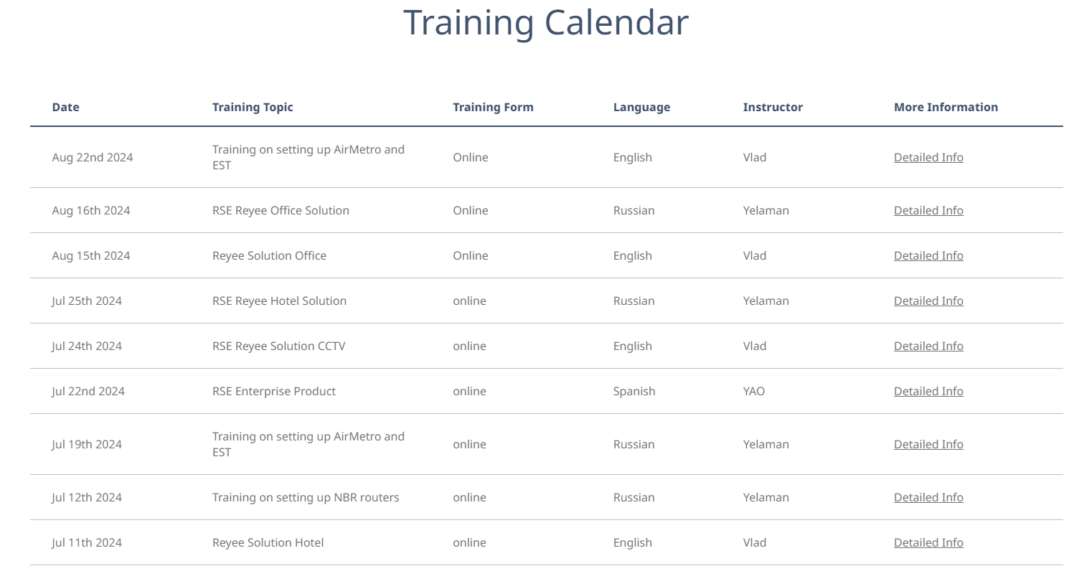
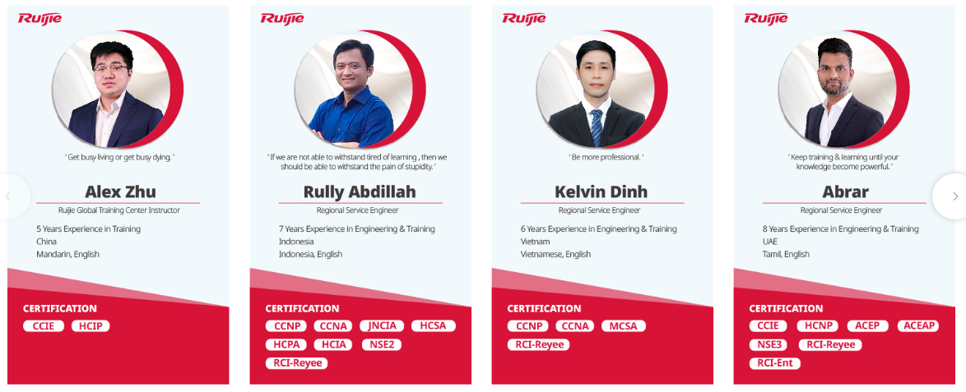
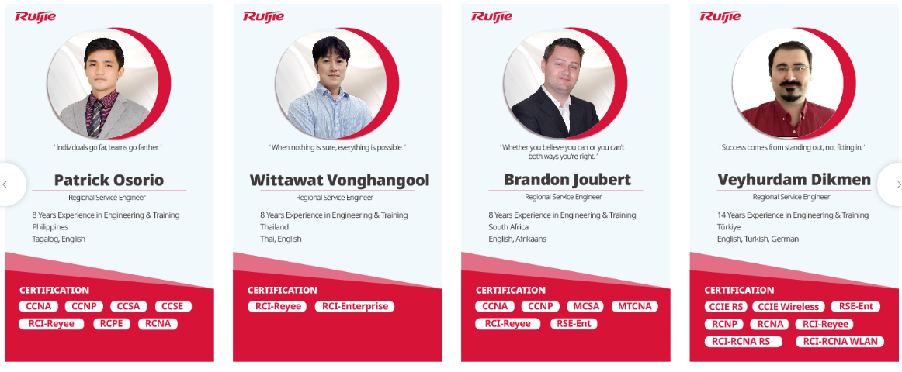

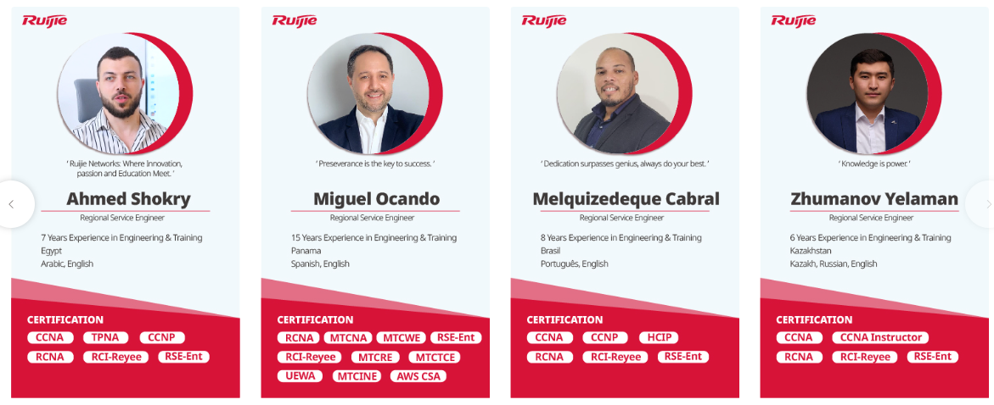
Online Learning Resource: Training Webpage
Quick viewing of training schedule
Detailed information and training materials are provided in the Training Calendar.
Learn more about the official training system and instructor
Training Introduction and Training Instructor sections help you know Ruijie training.
https://www.ruijienetworks.com/support/training

Slide 27
Ruijie Warranty and
R-Care+ Service

Slide 28
Product Warranty - Global Services Policy Summary
1. For Reyee and Enterprise Distribution entry-level products purchased from Ruijie after February 1st, 2024, now they feature a unified RMA support service, offering One-to-One Replacement Service.
2. For Enterprise Distribution middle and high-end products purchased from Ruijie after February 1st, 2024, Ruijie will provide a Return For Repair service to customers.
Products Lines | Product Series | Hardware Support |  |  | Software support (OS / Firmware) | Remote Technical Support
 |  | Warranty Duration | Return for Repair (RFR) | One-to-One Replacement | Software Updates | TAC Support (9*5 local time) | RITA Online Self-Services Support (24x7 Online)
Reyee & Consumer | Reyee（NBS&NIS Series） | 5 Years | N/A | √ | √ | √ | √
 | Reyee and Home Wi-Fi Series | 3 Years | N/A | √ | √ | √ | √
Enterprise entry-level products | S2915-L Series and CS83 Series | 3 Years | N/A | √ | √ | √ | √
 | AP, PoE Adapter, EG, and Firewall Series | 3 Years | N/A | √ | √ | √ | √
 | XG, SFP, GBIC Transceiver and cables | 3 Years | N/A | √ | √ | √ | √
Enterprise mid and high-end products | CS85/86/88 Series and Data Center Series | 3 Years | 9x5x15CD-Ship | N/A | √ | √ | √
 | AC Series | 3 Years | 9x5x15CD-Ship | N/A | √ | √ | √
 | QSFP Transceiver and cables | 3 Years | 9x5x15CD-Ship | N/A | √ | √ | √
Note：Ruijie provides local spare parts warehouse delivery services in UAE, Saudi Arabia, Türkiye, Thailand, Indonesia, and Vietnam to further improve repair efficiency, and more countries/regions will update continually.
Please kindly refer to the following website for more service policies:
https://www.ruijienetworks.com/support/servicepolicy

Slide 29
Product Warranty for 6 Early Bird Countries
Free Warranty RMA upgrade policy for 6 Early Bird Countries Gold and Silver Channel Partners.
Upgrade policy Period: Starts from April 1st, 2024 to December 31st, 2024. Ruijie provides free upgrades within the basic warranty period.
Customers: Gold and Silver Channel Partners
Country/Region: UAE, Saudi Arabia, Türkiye, Thailand, Indonesia and Vietnam
Available Products: Ruijie Enterprise Distribution mid and high-end products which are sold-out by VAD in 2024.
Products Lines | RMA Policy (Before the upgrade) | **Free Warranty RMA Upgrade Policy
Enterprise entry-level products | One-to-One Replacement Service *By VAD partners | No Upgrade
Enterprise mid and high-end products | Return for Repair (RFR) *By Ruijie Networks | *9x5xNBD-Shipment AHR *By Ruijie Networks
Note: NBD-Shipment=Next Business Day shipment, no committed delivery SLA;
How to obtain warranty RMA upgrades service, please contact the Ruijie post-sales team or TAC team.

Slide 30
Product Warranty & R-Care+ Service
Your mission-critical network requires 24x7x365 attention and needs the backing of R-Care+ for Ruijie support services.
R-Care+ provides essential support entitlements to ensure business continuity, featuring 24x7 TAC, NBD/4H AHR, and onsite service support for uninterrupted network operations.
Service Level | Annual Renewal Warranty | 5Y Warranty Service Package |  | R-Care+ Device Maintenance Services
 |  |  |  | AHR Standard | AHR Golden | On-site Standard | On-site Golden
Products | 9x5x15CD-S Basic RFR Service | 5Y Basic RFR Service | 5Y NBD-S AHR Service | 9x5xNBD Standard AHR Service | 24x7x4 Golden AHR Service | 9x5xNBD Standard On-site Service | 24x7x4 Golden On-site Service
Remote Technical Assistance | Live chat & Hot line：9x5（local business time） | Live chat & Hot line：9x5（local business time） | Live chat & Hot line：9x5（local business time） | Live chat & Hot line： 24x7 | Live chat & Hot line：24x7 | Live chat & Hot line：24x7 | Live chat & Hot line：24x7
Online Self-help Support | Yes | Yes | Yes | Yes | Yes | Yes | Yes
Software Updates | Up to EOO+2 years | Up to EOO+2 years | Up to EOO+2 years | Up to EOO+2 years | Up to EOO+2 years | Up to EOO+2 years | Up to EOO+2 years
RMA Service | 9x5x15CD-Shipment | 9x5x15CD-Shipment | 9x5xNBD-Shipment | 9x5xNBD-arrive | 24x7x4-arrive | 9x5xNBD | 24x7x4H
On-site Service Level | / | / | / | / | / | 9x5xNBD-arrive | 24x7x4H-arrive
Note:
RFR：Return for Repair
AHR：Advanced Hardware Replacement
NBD：Next Business Day
9*5*15CD-S：15 Calendar Day Shipment

Slide 31
Product Warranty & R-Care+ Service
Deliverable | Product Warranty | R-Care+ Service
Remote Technical Assistance
Priority Access Ruijie TAC | Yes with conditions^{①} | YES
Expert Hotline | Yes with conditions^{①} | YES
Hot line & Live chat SLA | 9x5 | 24x7x365
Hardware Support
Ruijie Case Portal Platform^{②} | YES | YES
Ruijie Local Spare Part Warehouse | Yes with conditions^{①} | YES
Local 9x5xNBD-Shippment (NBD AHR) ^{①} | Yes with conditions^{①} | YES
AHR and onsite committed delivery SLA | × | YES
Without Additional Charges
Faster Access
Higher Efficiency
① Limited Country/Region and partners: Gold and Silver partners in UAE, Saudi Arabia, Türkiye, Thailand, Indonesia and Vietnam. Enhance efficiency, reduce costs with instant software access and streamlined asset management and online RMA.
② Ruijie Case Portal Platform：Increase operational efficiency and lower operational costs with immediate online access to software as well as simplified asset tracking and online RMA

Slide 32
RMA Policy: What is RMA
Return Material Authorization:
It is the main process for handling the repair or replace customer’s defective products during warranty or post warranty.
Three types of RMA process respond to customer requirements.
Submit RMA Application
Fault & SLA Confirmation
Defective Parts Send Back
Send Defective Parts Back
Replacement Part Ship Out
Warehouse Receipt
Customer Receipt
Warehouse Receipt
Defective Parts Repaired
These two steps are operated by local ASP
Defective Parts Sent Back
Replacement Part Ship Out
N
Y
Repaired Part Ship Out
Defective parts can be sent to Ruijie WH by customer or Ruijie arrange logistics pick up within 15CD
Replacement Part Ship Out
Customer Receipt
Customer Receipt
Warehouse Receipt
One-to-One Replacement Service
Return for Repair (RFR) Service
Advance Hardware Replacement
(AHR) Service

Slide 33





RMA Process Introduction: One-to-One Replacement Service
Key Points:
ASP or end user submits RMA application.
ASP will send replacement parts to end user within 15CD once get defective parts.
ASP shall outbound replacement parts in CSM system as well.
Submit RMA Application
Fault & SLA
Confirmation
Warehouse
Transportation
Customer
Defective Parts
Repaired Parts

Slide 34








RMA Process Introduction: Return for Repair (RFR) Service
Key Points:
Customers send defective parts to Ruijie first.
Ruijie sends repaired parts back to customer within 15CD once received defective parts.
If the defective parts can’t be repaired, Ruijie will provide a replacement model.
Application submit and confirm
Repair Center
Warehouse Receipt
Customs
Customs
Customer
Defective Parts
Repaired Parts
Notes:
Expenses related to shipping defective parts back to Ruijie shall be undertaken by the customer: including local transportation, local customs clearance on the customer side, and international logistics from the customer to Ruijie.
Expenses related to shipping repaired/replace parts back to the customer shall be undertaken by Ruijie: including local transportation, local customs clearance on Ruijie side, and international logistics from Ruijie to the customer.
For the country in which Ruijie have local warehouses, customer can send defective parts to Ruijie's local warehouses (such as Turkey, UAE, Saudi Arabia, Indonesia, Thailand and Vietnam, and more countries will update continually), Ruijie will provide repaired/ replacement parts within SLA.

Slide 35





RMA Process Introduction: Advance Hardware Replacement (AHR) Service
Key Points:
Ruijie will send good parts within SLA first once the application is approved.
Customer shall send defective parts to Ruijie local warehouse or Ruijie picks up defective parts from the customer within 15CD after the customer received good parts.
Submit RMA Application
Fault & SLA
Confirmation
Warehouse
Transportation
Customer
Defective Parts
Repaired Parts

Slide 36



Product R-Care+ Experience
Saudi Arabia, Government customers, Core product, IDC, high business continuity requirements
Türkiye, Enterprise customer, Core product, Longer warranty period requirements
Singapore, Large Internet companies, working network, Core products, Faster service, Higher response requirements
Preventable
Reduce device’s fault rate and extent device’s service life
Forecast potential risks in the network
Get patches for known bugs
Secure
Handle daily maintenance problems
Reduce risks during critical operations
Network guarantee for critical moments
Faster-recovering
Locate faults and recover business
Massive spare parts warehouses to support your device replacement
Economic
Fixed annual maintenance fee
No extra fee for device’s maintenance and replacement
Safeguarding customers’ long-term service investment returns
Minimize Losses from Equipment Failures
Ruijie partners with you by sharing responsibilities and risks

Slide 37
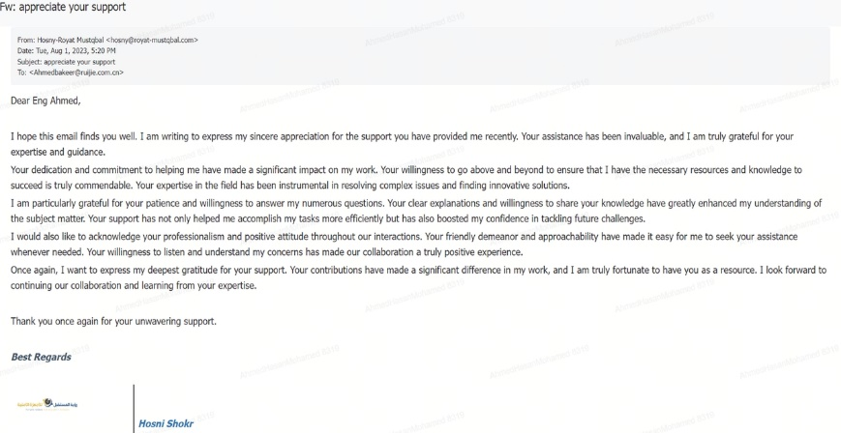
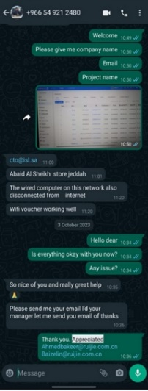
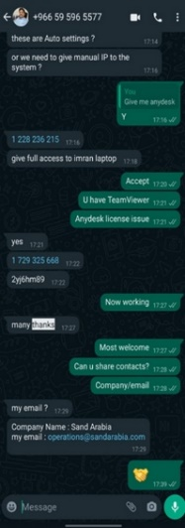
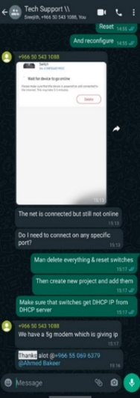
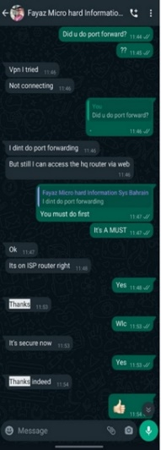
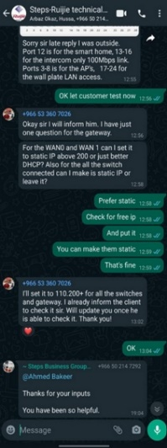
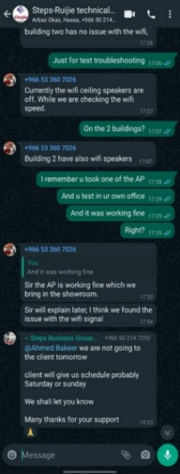

Customer Voices of Ruijie Service Experience
Ruijie Service Value: Provide faster and more professional services for customers
Voices from Customers:
Ruijie regional post-sales engineers have provided customers with more service access channels, more efficient service responses, more professional problem-solving solutions, and more valuable empowerment trainings.
Instance 1 : Excellent Technical Support
Ruijie META-Saudi Arabia Engineer: Ahmed Hasan Mohamed
Keywords: Anytime & Everywhere Access, Efficient, Expert, Mastery of Complex Issues, Proactive, Gentlemanly Patience, Customer Satisfaction

Slide 38
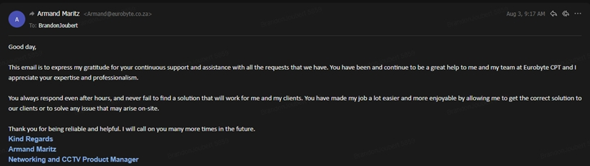
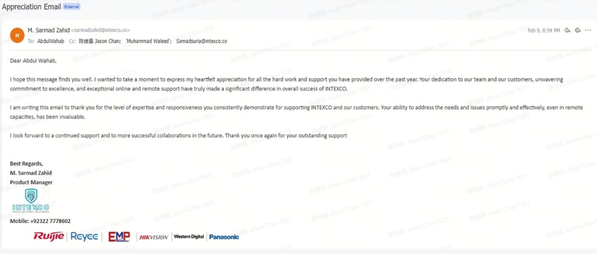
Customer Voices of Ruijie Service Experience
Instance 2 : Professional Problem-solving Solutions
Ruijie META-UAE Engineer: BrandonJoubert
Ruijie META-Pakistan Engineer: AbdulWahab
Keywords: Professional, Dedicated, Reliable, Willing to assist, Unwavering Commitment, Effective in Problem-solving

Slide 39
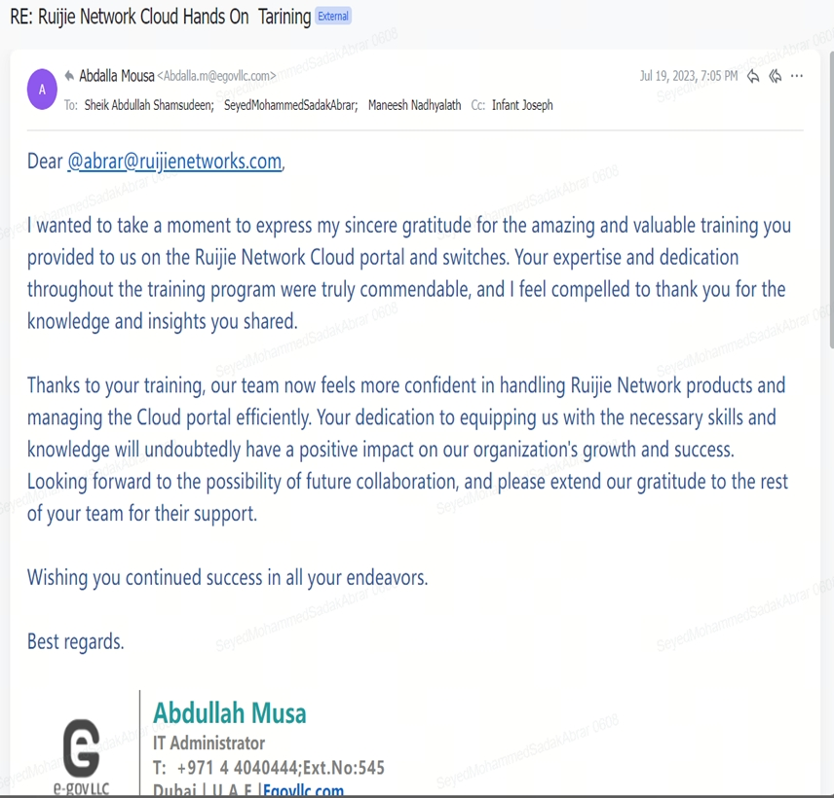
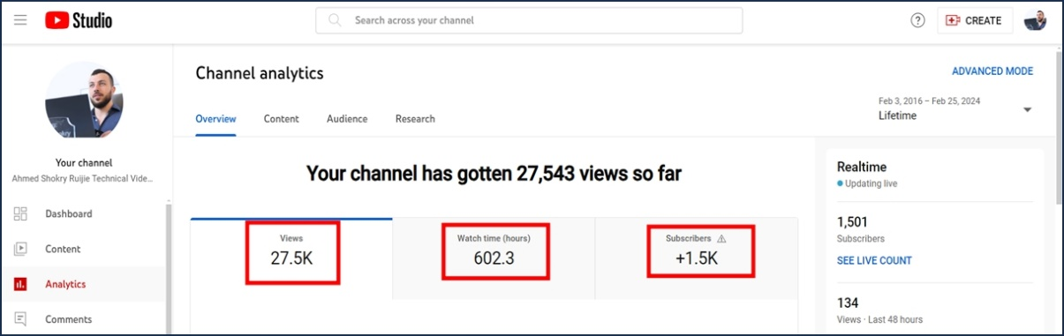
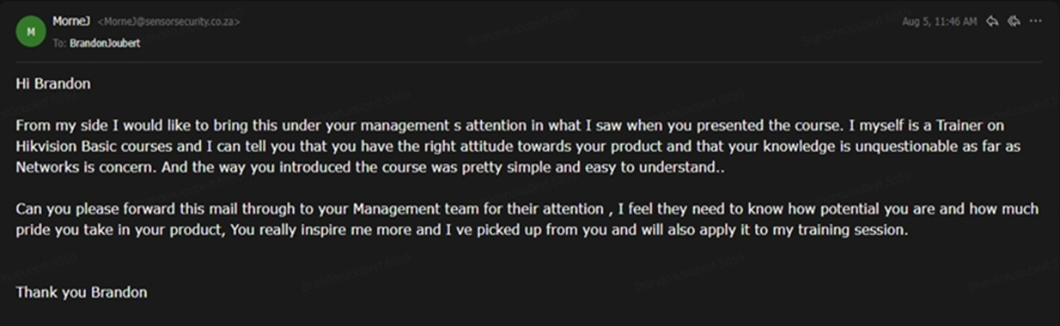
Customer Voices of Ruijie Service Experience
Instance 3 : Valuable Empowerment Training
Ruijie META-UAE Engineer: SeyedMohammedSadakAbrar
Ruijie META-Egypt Engineer: Ahmed
Ruijie META-UAE Engineer: BrandonJoubert
Keywords: Wonderful, valuable, professional, dedicated, growing together with customers, successful

Slide 40
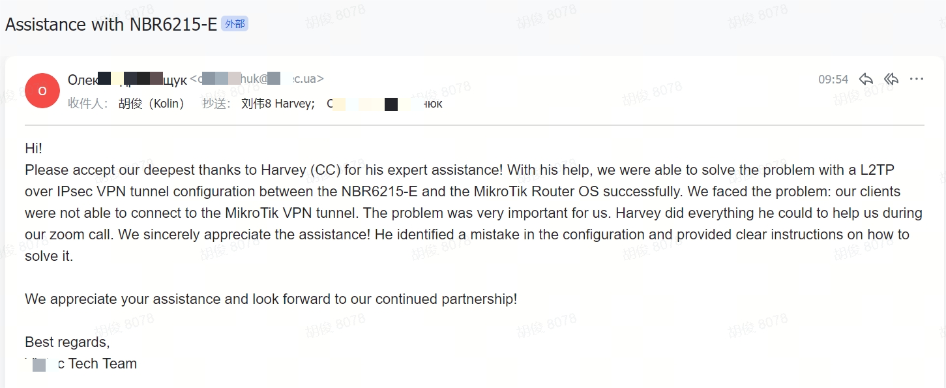
Customer Voices of Ruijie Service Experience
Instance 4 : Efficiently TAC Support
Ruijie TAC Engineer: Harvey
Keywords: Tickets Support, solve issues with customers, fast，effectively

