Slide 1
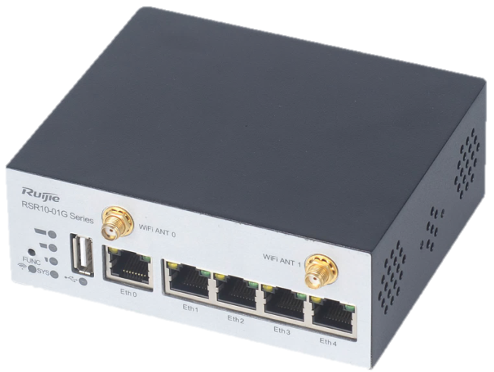
Upgrade Firmware Ruijie RSR10-01G-T(W) to English
February 2018

Slide 2
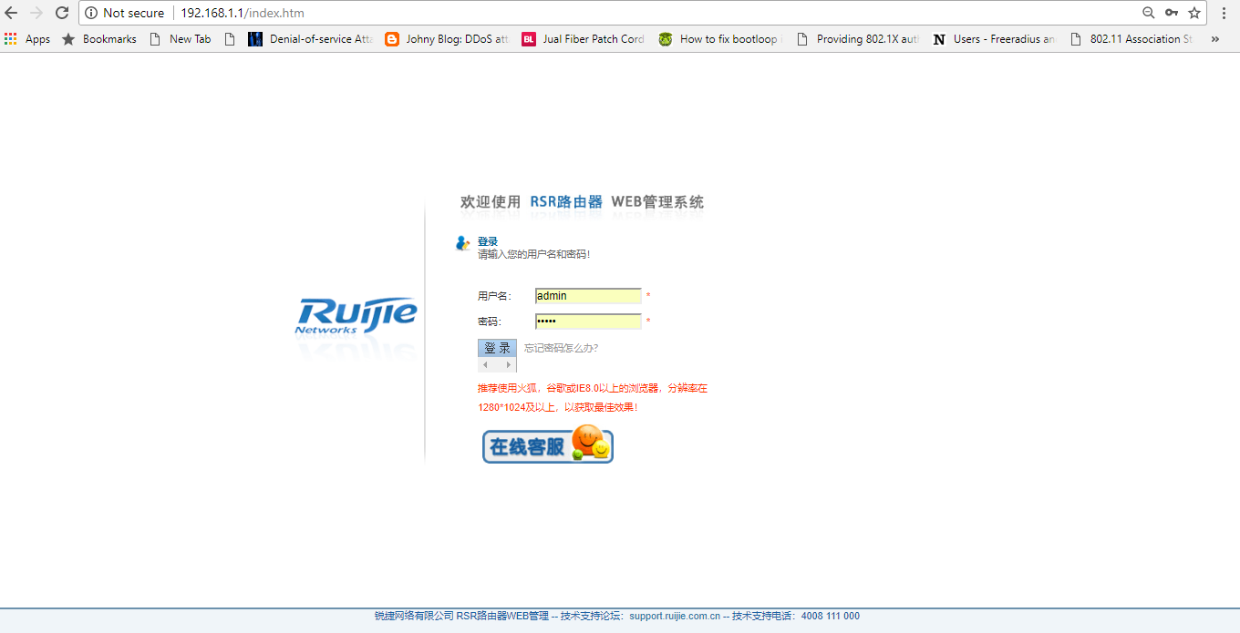
Login to WEB GUI
Configure PC using 192.168.1.xxx/24 IP
Plug LAN cable PC to port1 Router
  Ping to verify
Open http://192.168.1.1 on browser and login using username/password : admin/admin

Slide 3
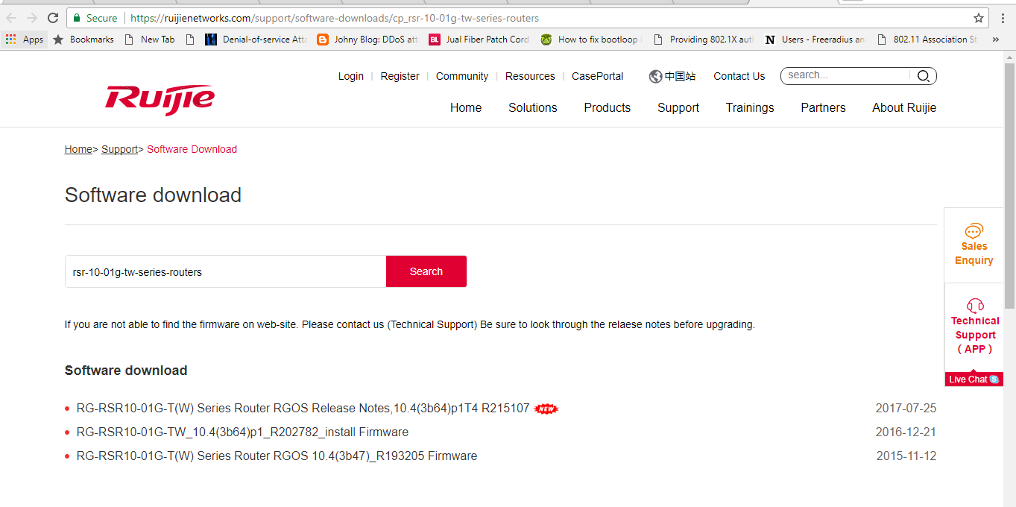
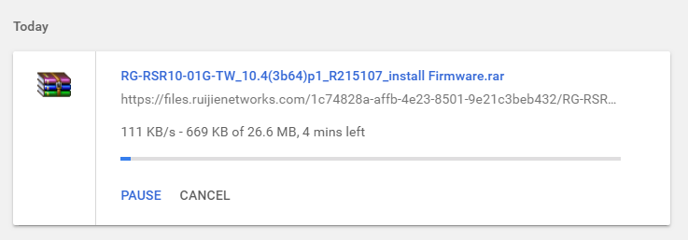
Download Firmware from website
Open this Link :
https://ruijienetworks.com/support/software-downloads/cp_rsr-10-01g-tw-series-routers

Slide 4
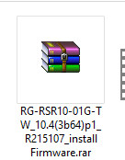
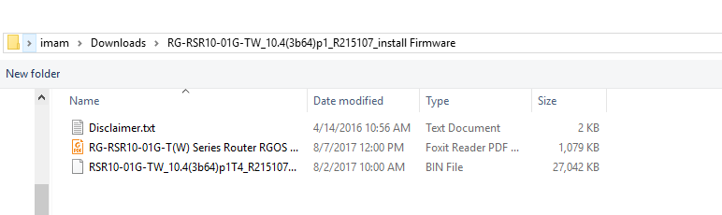
Extract firmware file

Slide 5
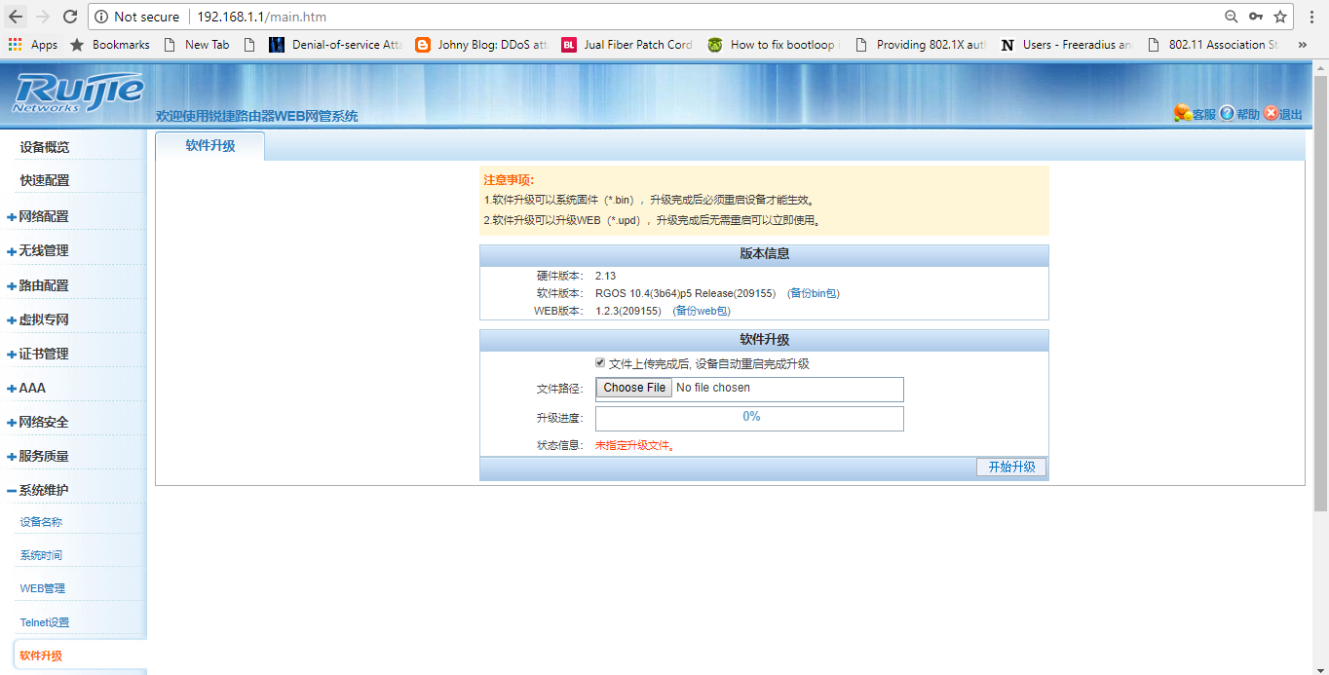
Upgrade firmware to English Ver.

Slide 6
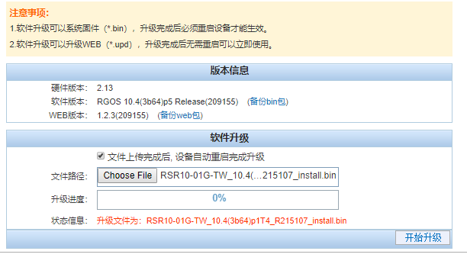

Upgrade firmware to English Ver.
Choose firmware that we have downloaded before

Slide 7
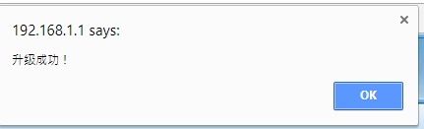
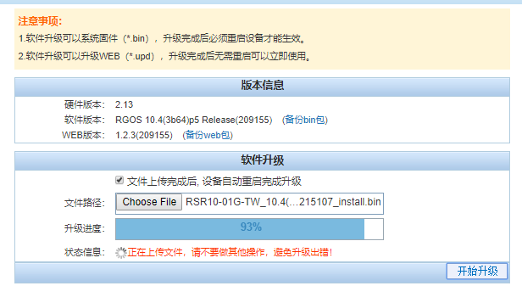
Upgrading process
Waiting until upgrade process bar to 100% then router will reboot
It say , upgrade already finished

Slide 8
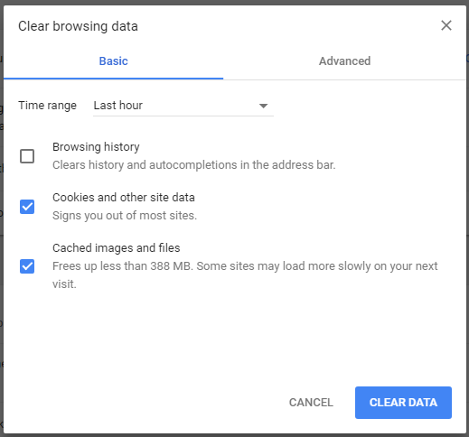
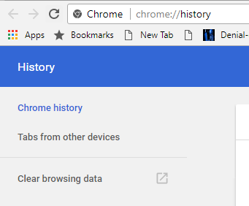
Clear Browser Data (cache)
On browser, push CTRL + H to open history menu
Choose clear browsing data
Choose delete 1 hour data

Slide 9
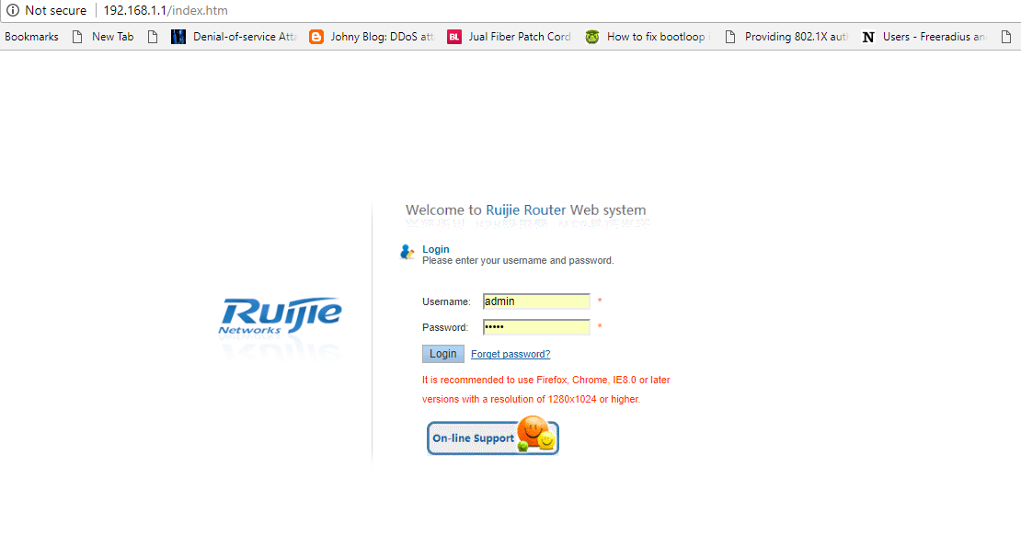
Login again

Slide 10
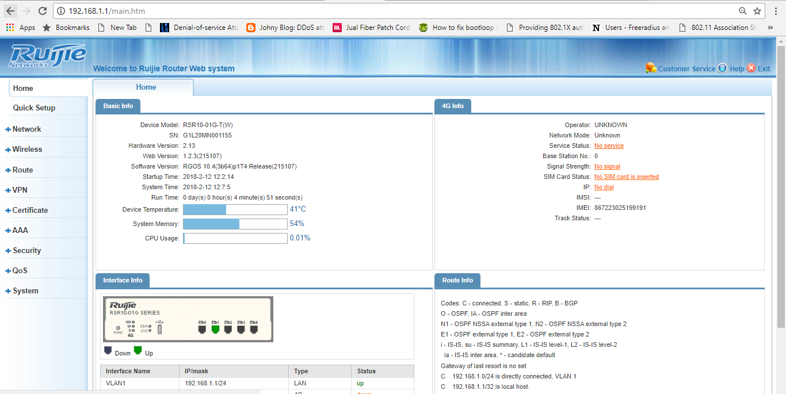
GUI already in English

Slide 11
Documentation File
Datasheet https://ruijienetworks.com/resources/preview/41510
Installation Guide https://ruijienetworks.com/resources/preview/41510
Configuration Guide https://ruijienetworks.com/resources/preview/57877

